Slide 1
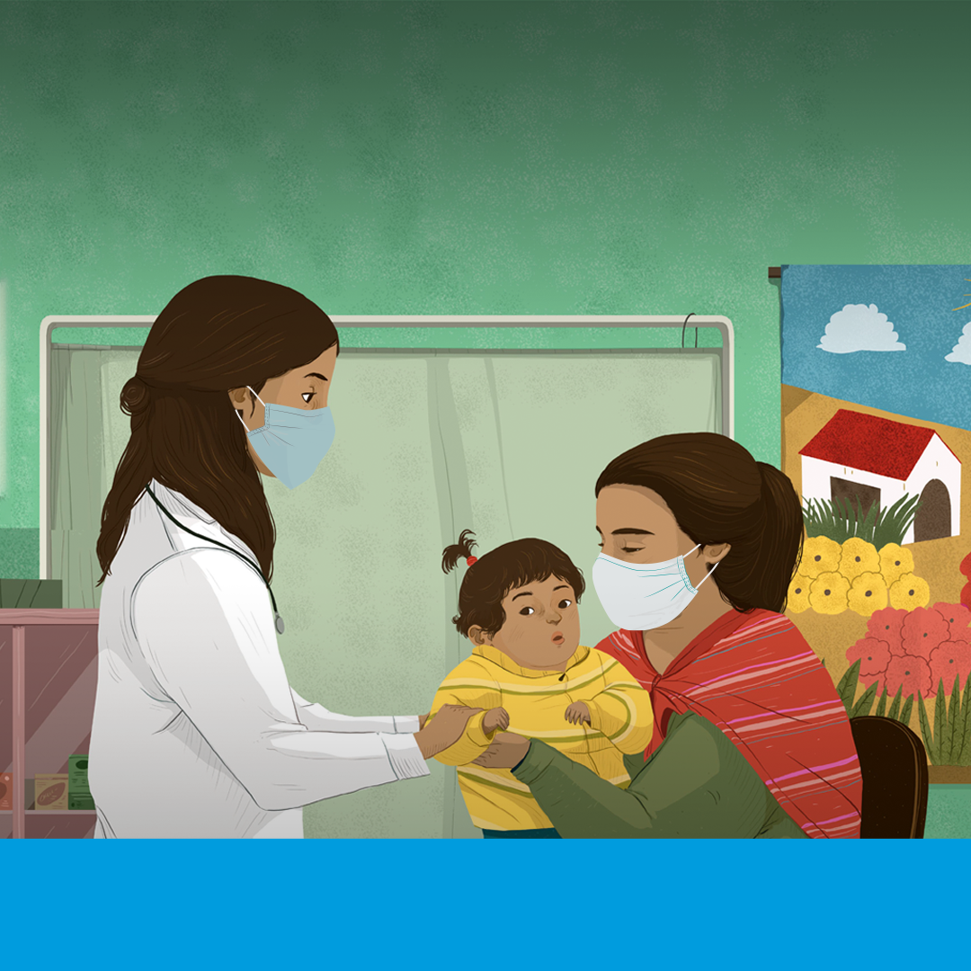


  PREVENTING ANTIMICROBIAL
  RESISTANCE TOGETHER
Always get advice from a health worker when taking antimicrobial medicines such as antibiotics, antivirals, antifungals and antiparasitics.

Slide 2
  PREVENTING ANTIMICROBIAL
  RESISTANCE TOGETHER
Antimalarial medicines are critical to fighting malaria.
To prevent drug resistance, take the full treatment of
antimalarial medicines prescribed by your health care provider.

Slide 3
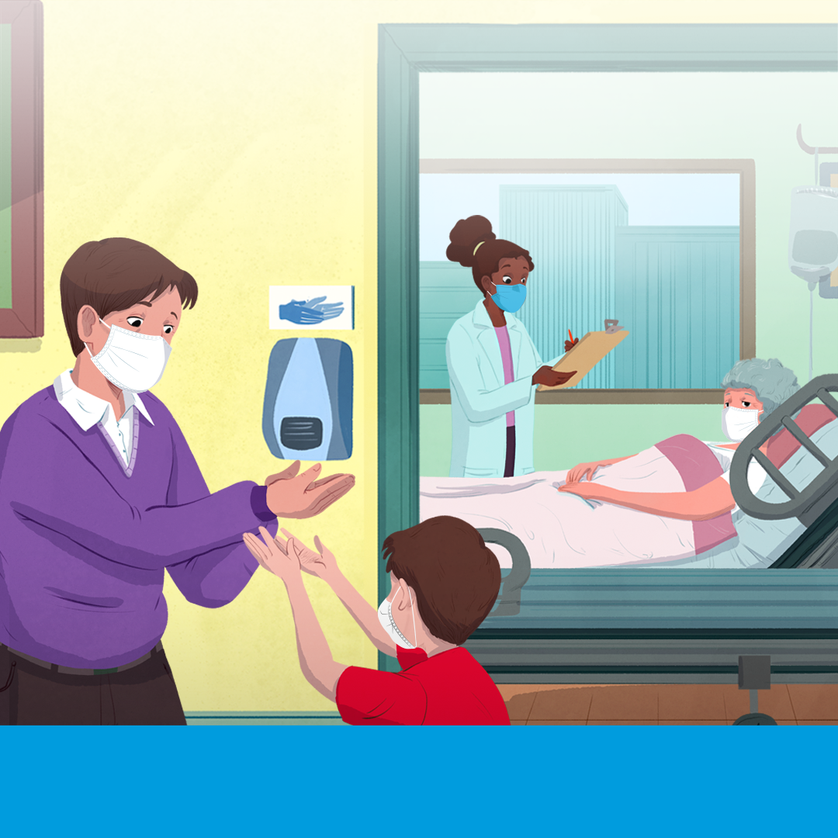
  PREVENTING ANTIMICROBIAL
  RESISTANCE TOGETHER
Antimicrobial resistance leads to longer hospital stays, higher medical costs and increased mortality.
Good hand hygiene can help limit the spread of infections.

Slide 4
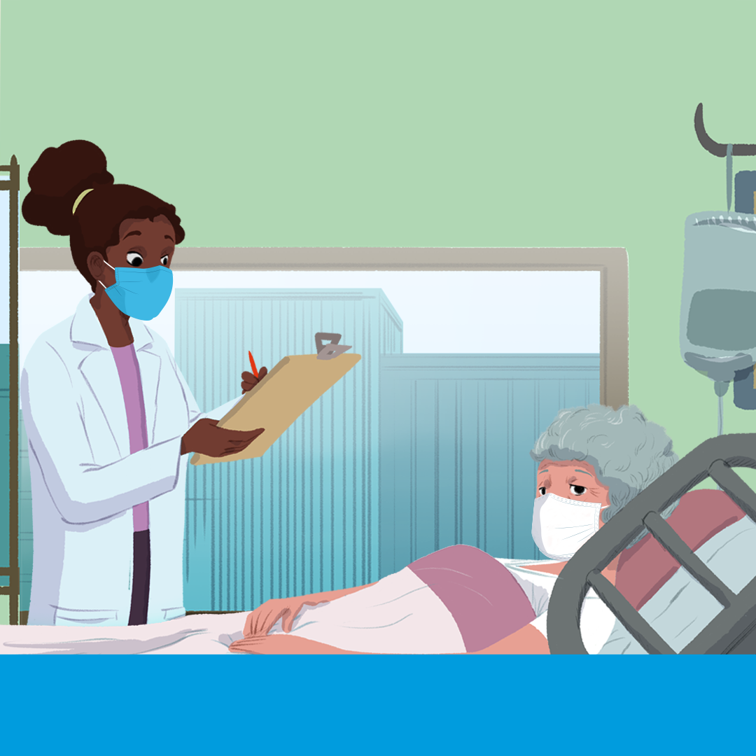
  PREVENTING ANTIMICROBIAL
  RESISTANCE TOGETHER
Antimicrobials protect vulnerable people whose immune systems are not working fully, including those receiving cancer care.
Prevent drug resistance to keep these medicines working.

Slide 5
  PREVENTING ANTIMICROBIAL
  RESISTANCE TOGETHER
1 in 10 patients get an infection while receiving care.
Health workers can reduce the spread of
infections by ensuring their hands, instruments
and environment are kept clean.

Slide 6
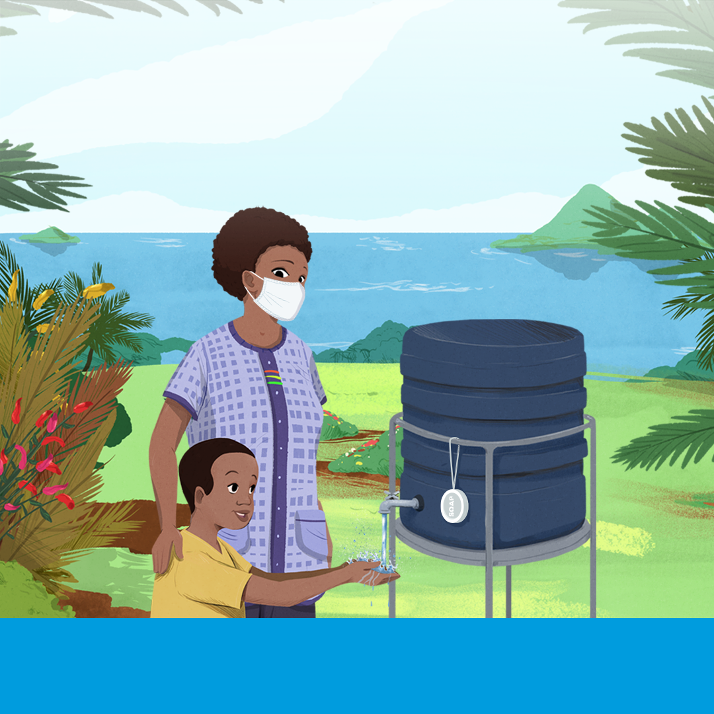
  PREVENTING ANTIMICROBIAL
  RESISTANCE TOGETHER
Access to safe water, sanitation and hygiene (WASH) in homes and health facilities can reduce antibiotic use to treat diarrhoea by up to 60%.
WASH helps prvent drug
resistant infections, saves
lives and reduces health costs.

Slide 7
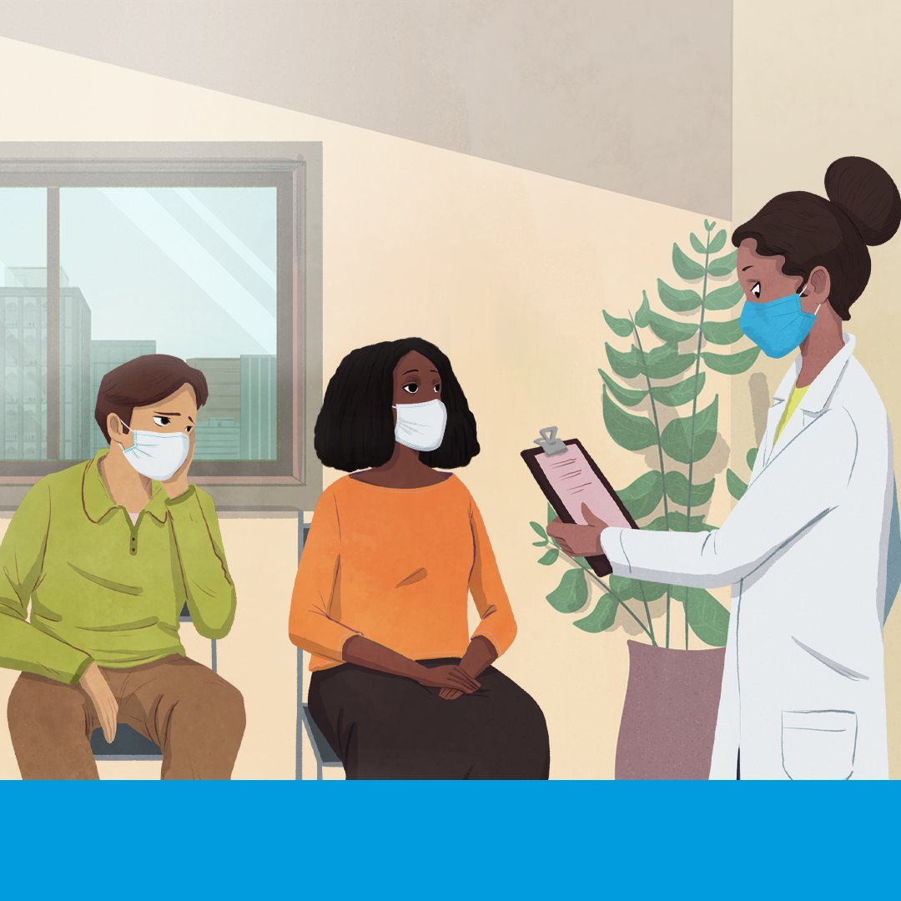
  PREVENTING ANTIMICROBIAL
  RESISTANCE TOGETHER
Ensuring the continuation of essential health services during COVID-19 is more important than ever.
Continue TB and HIV treatments
to prevent drug resistance.

Slide 8
  PREVENTING ANTIMICROBIAL
  RESISTANCE TOGETHER
Interrupting HIV treatment makes drugs ineffective and HIV harder to treat.
Continue TB and HIV treatments
to prevent drug resistance.

Slide 9
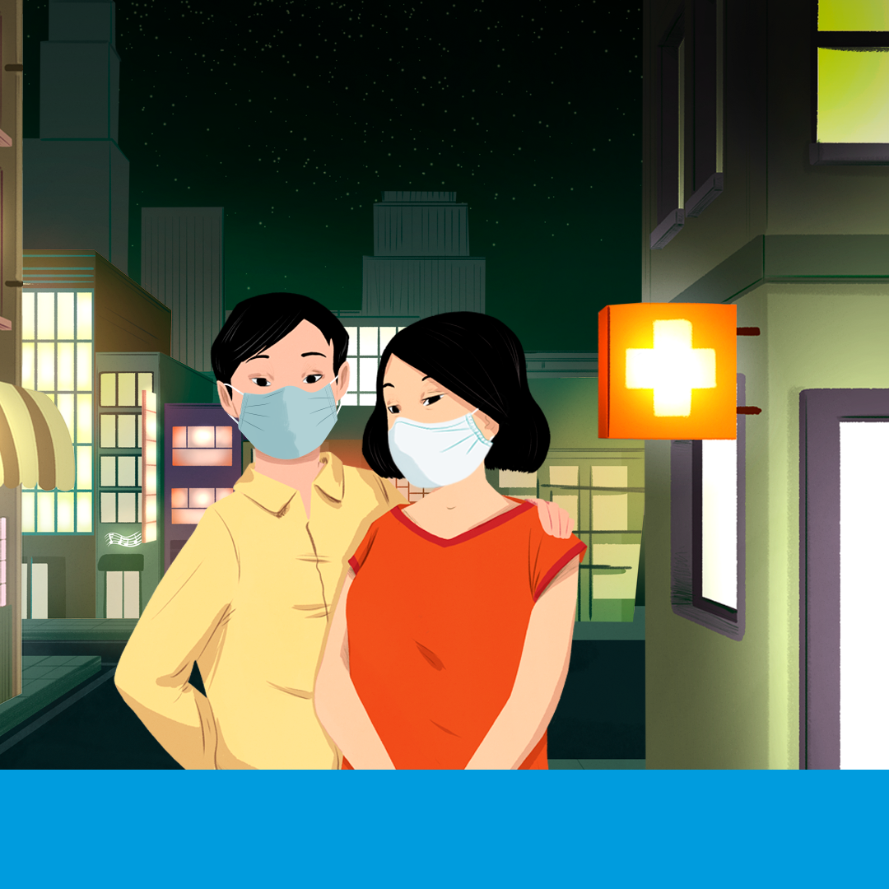
  PREVENTING ANTIMICROBIAL
  RESISTANCE TOGETHER
Drug resistance is increasing in post-operative infections, making surgeries including caesarean sections, organ transplants, and joint replacements riskier.

Slide 10
  PREVENTING ANTIMICROBIAL
  RESISTANCE TOGETHER
Drug resistance is making sexually transmitted infections (STIs) challenging to treat so practice safer sex.
If you think you have an STI, do not self-medicate. See a health worker for an accurate diagnosis and treatment.

Slide 11
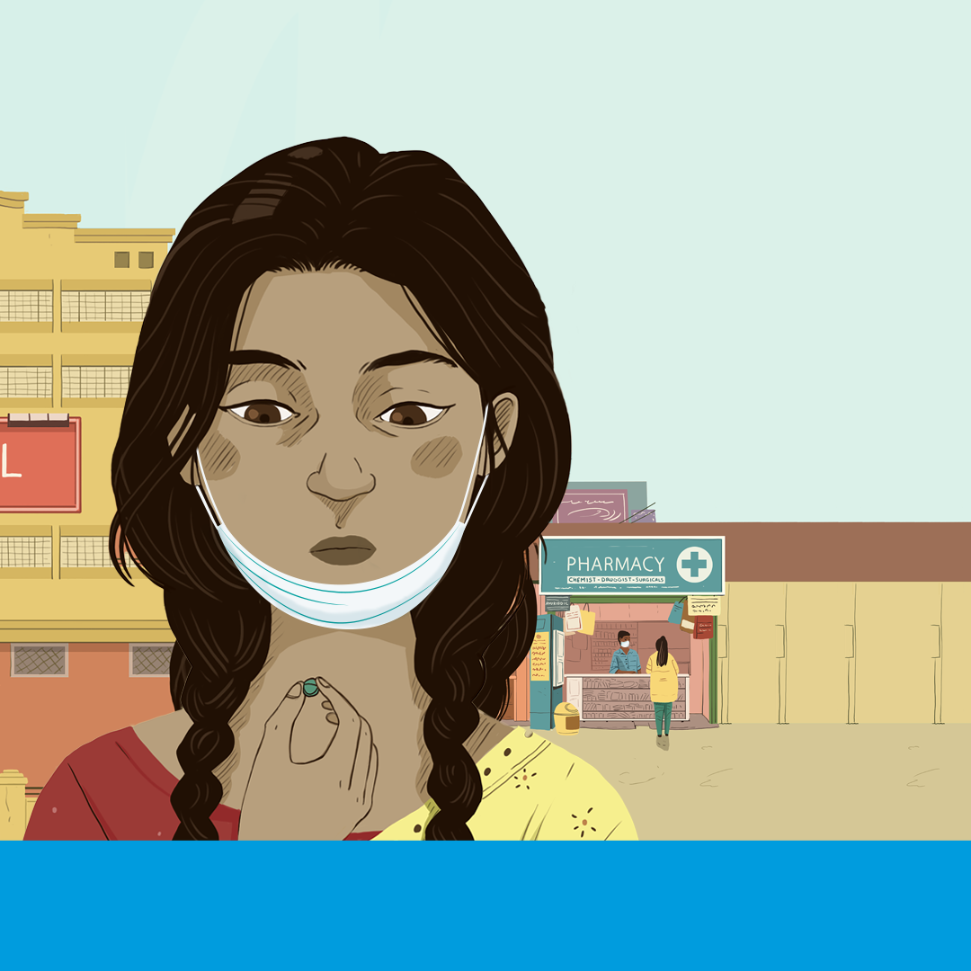
  PREVENTING ANTIMICROBIAL
  RESISTANCE TOGETHER
Substandard and falsified medicines contribute to antimicrobial resistance.
Increased regulation and
enforcement promotes
availabilty of quality
medicines for all.

Slide 12
  PREVENTING ANTIMICROBIAL
  RESISTANCE TOGETHER
Drug resistance has
made tuberculosis (TB) harder to treat.
Continue and complete
your full treatment to
reduce drug-resistant TB.

Slide 13
  PREVENTING ANTIMICROBIAL
  RESISTANCE TOGETHER
Keep antimicrobial medicines
working through correct use:
> Take them only when prescribed
> Follow directions on treatment dosage and duration, even if you feel better
> Don't share or use leftover antimicrobials

Slide 14
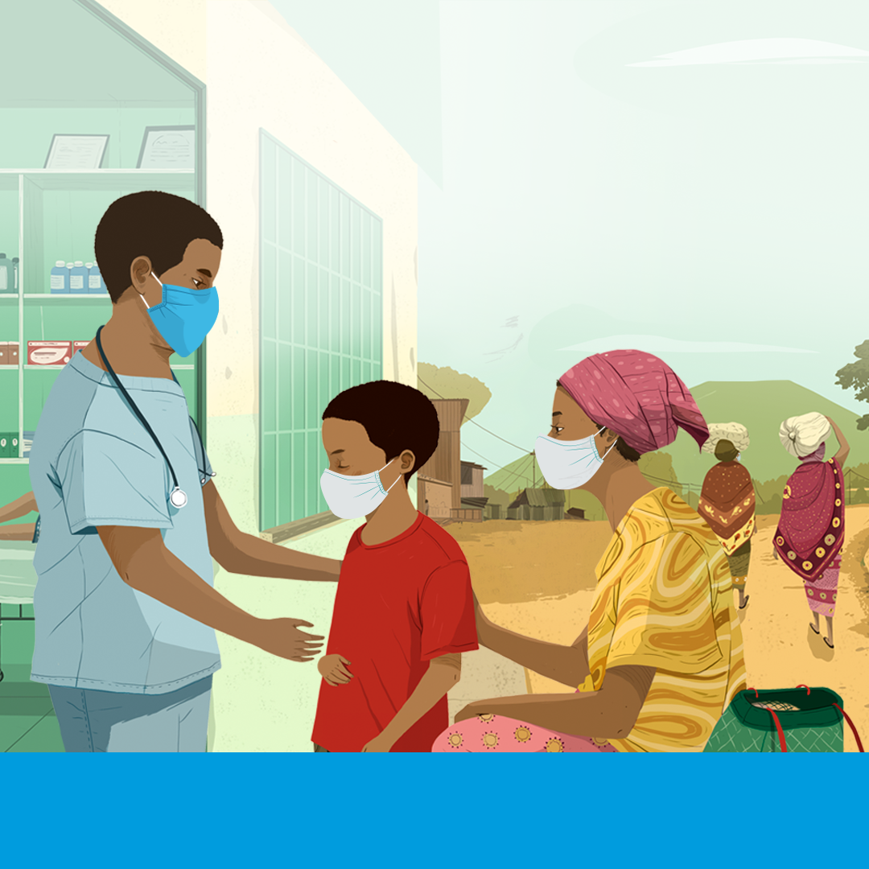
  PREVENTING ANTIMICROBIAL
  RESISTANCE TOGETHER
Around half a million people fall ill with drug-resistant tuberculosis (TB) every year, making it harder to treat.
Complete your full treatment to reduce drug-resistant infections.

Slide 15
  PREVENTING ANTIMICROBIAL
  RESISTANCE TOGETHER
Resistance is increasing in parasitic infections such as intestinal worms and malaria.
Always consult a health worker for an accurate diagnosis and take the full treatment regimen
as directed.

Slide 16
  PREVENTING ANTIMICROBIAL
  RESISTANCE TOGETHER
Antimicrobial resistance occurs when bacteria, viruses, fungi and parasites change over time and no longer respond to medicines.
Use antimicrobial as directed by a health worker to preserve the effectiveness of these medicines.

