Slide 1


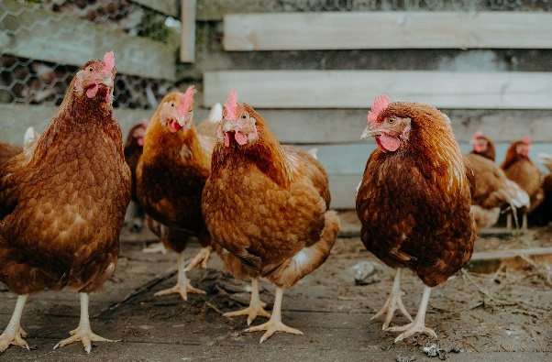

ANTIBIOTICS REDUCTION IN THE ITALIAN POULTRY SECTOR

Slide 2
POSITION
Given the widespread consumption of antibiotics in both humans and animals, we decided to be proactive and to be part of the SOLUTION
The poultry industry has successfully implemented strategies to dramatically reduce the use of ANTIBIOTICS
PREVENTION throughout the whole and fully integrated supply chain
We built a voluntary and science-based plan to REDUCE THE USE OF ANTIBIOTICS IN LIVESTOCK farms, unique in the Italian livestock sector
APPROACH

Slide 3
THE PILLARS
Healthy and resistant bacteria-free breeders
01
Sustainable farming environment
02
Nutritional aspects and water quality
03
Targeted and appropriate therapies in case of diseases
04
Improvement in structures and management
05
Develop and consolidate a preventive approach
Respect biosecurity and animal welfare
Continuous training
Ban for antibiotic prophylaxis in hatchery and farming
Ban for colistin in broilers and only injectable use for turkeys (2017)
COMMITMENTS
Ban for Cephalosporins of 3rd and 4th generation (2009)
Preference for narrow-spectrum antibiotics
Use of CIAs as a last resort

Slide 4
RESULTS 2015-2022
mg of active ingredient antibiotics /kg live weight per annum
​ | BROILER​ | TURKEY
2015 | 20,09​ | 31,12​
2016 | 13,78 | 23,01
2017​ | 7,46 | 16
2018 | 2,61 | 10,7​
2021 / 2022 | 0,7 | 2,57
Target: -15% →Achievement: -39,95%
TARGET ACHIEVED 2 YEARS IN ADVANCE
Target: -40% →Achievement: -50%
2019 - electronic receipt started in Italy:
official data collected by the Ministry of Health in the “Classyfarm” system, using the methodology DDDVET IT (Italian daily dose)
-96%
-92%

Slide 5
REDUCTION FOR SINGLE ACTIVE INGREDIENT
ACTIVE INGREDIENT | ∆ 2011 - 2019
Amphenicols | 166,69%
Aminoglycosides | -31,38%
Fluoroquinolone | -88,40%
Other Quinolones | -96,80%
Lincosamides | -78,15%
Macrolides | -82,63%
Penicillin | -82,01%
Polymyxins | -99,53%
Sulfonamides | -33,74%
Tetracycline | -87,55%
Others | -100,00%
Trimethoprim | 1,72%
Total | -79,95%
under others: 3d and 4d generations cephalosporins - banned before 2011
data collection was certified by a third body (CSQA) until 2019 under the methodology mg active principle/kg live weight

Slide 6
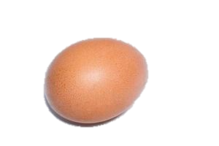
HOW?
Breeders
Hatchery
Efficient and well-managed cleaning and disinfection procedures
Avoid stress factors
Nutrition and feed management: Select ingredients with higher digestibility, a lower potential to increase gut viscosity, and minor risks of Clostridial or Salmonella contamination
Nests: quality hatching eggs is primarily a clean egg
Reject floor eggs
Work flow: Clean/dirty areas separation
All in all out setters /hatchers
Incubation batch based on:
    Flock age
    Holding time ( avoid >10 days )
    Egg Sanitation procedure
    Perfect monitoring of gas exchange T° + Rh

Slide 7
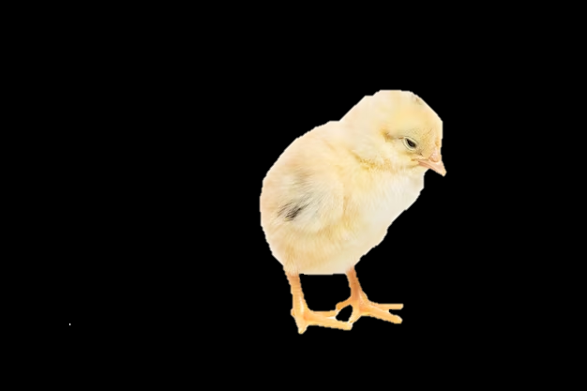
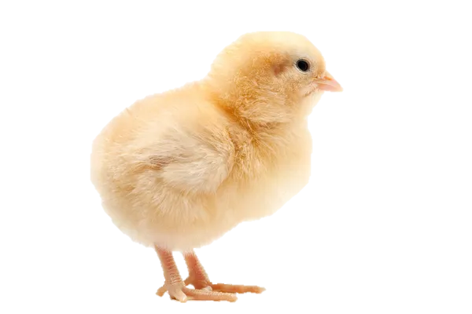

How?
Day old chicks
Fattening farms
Avoid long hold time shipment
Vaccine application: GMP
Strict hygienic rules on trolley, boxes, truckload, and unload procedures
All in all out
Cleaning and Disinfection procedures
Brooding area preparation:
  Fresh deep litter
  Feed papers
  Floor temperature
  Strict biosecurity measures

Slide 8
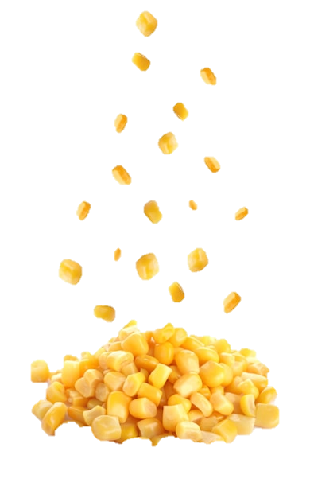
How?
Environmental control
Nutrition
Ventilation rate in tunnel ventilation is crucial
Heating system based on hot air generator (for better control of relative humidity and so litter quality)
T°, Rh, ammonia e Co2 to be integrated into automatic environmental control equipment to set the ventilation rate, especially in the first 14 days
Enhance gizzard and intestinal development early in life
Stimulate the early development of a healthy gut microbiome
Minimize contamination and development of pathogenic bacteria and protozoa

Slide 9

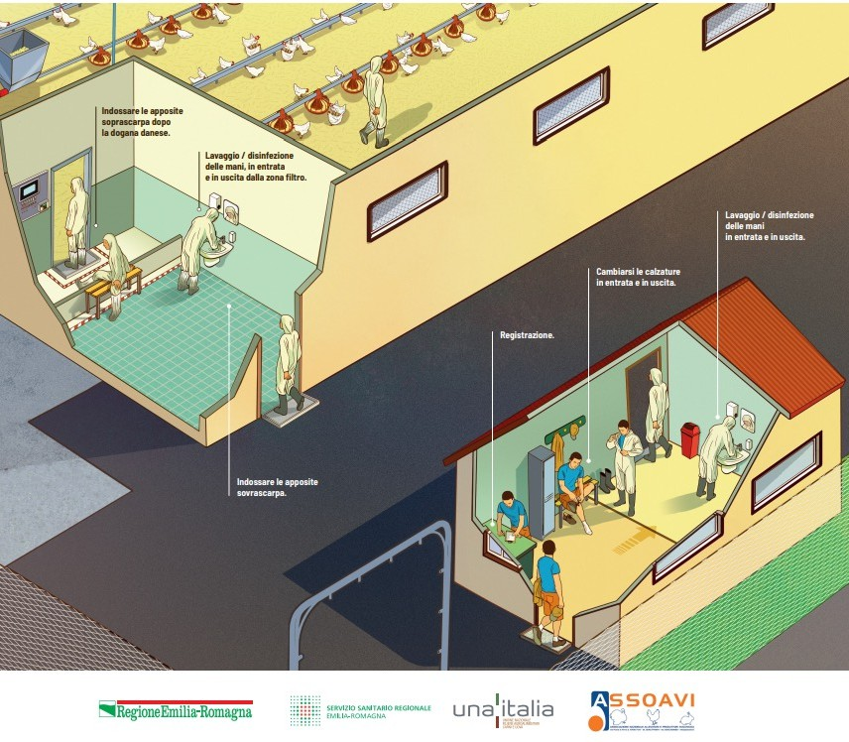

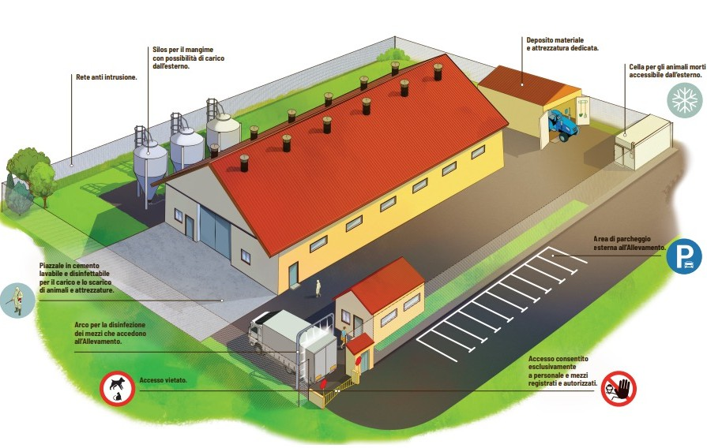
BIOSECURITY MEASURES

Slide 10
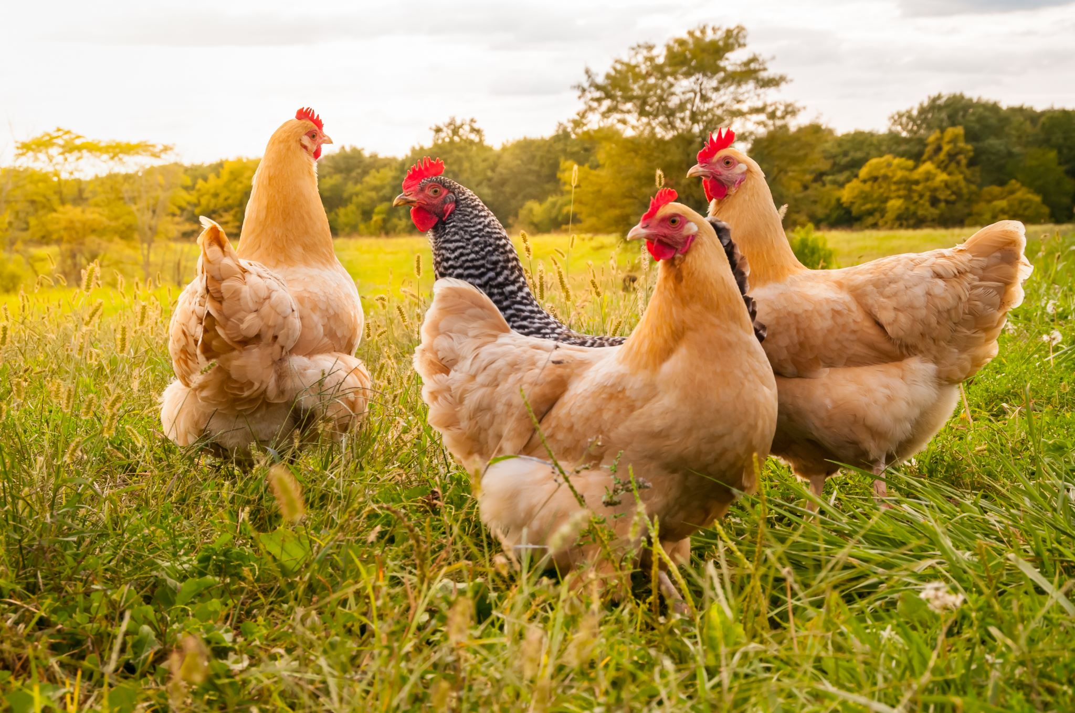
OUR FUTURE IS ONE HEALTH AT GLOBAL LEVEL
THANK YOU FOR YOUR ATTENTION!

