Slide 1


Slide 2

When people seek health care they are hoping to
get better.

Slide 3

Too often, they actually end up getting new infections - sometimes fatal.

Slide 4

Because of poor hygiene
in health care facilities.

Slide 5
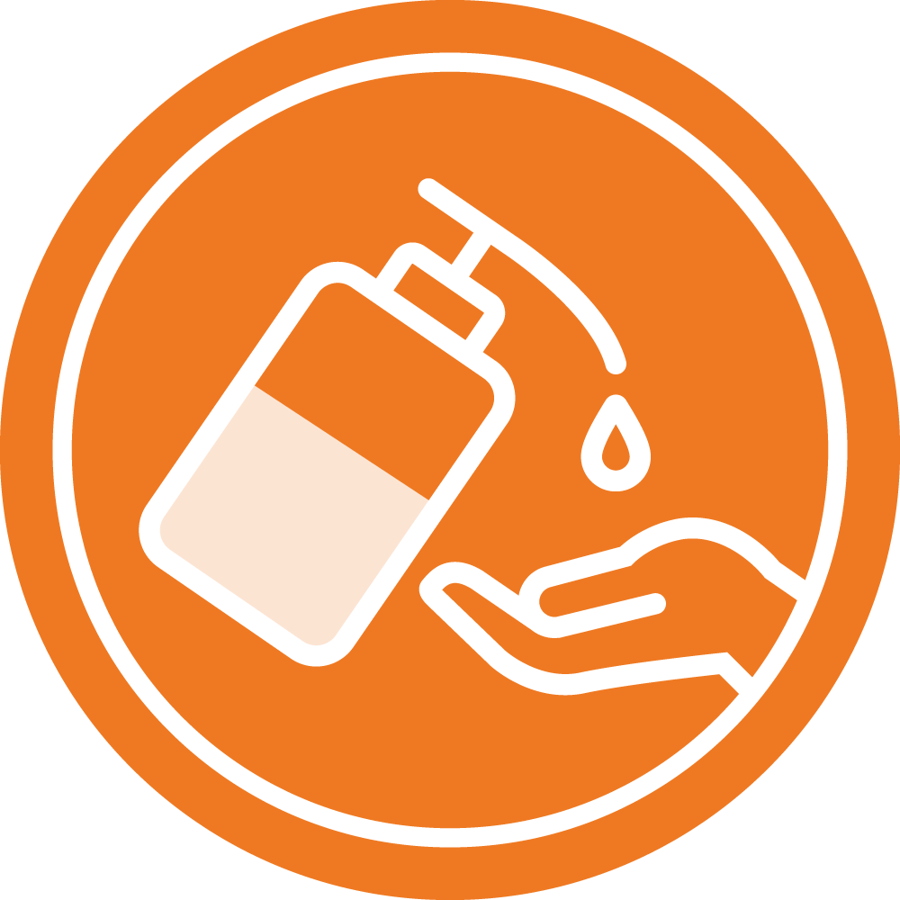
One way health care facilities can help stop this is by making sure that all health workers have access to the right hand hygiene and hand cleaning products.

Slide 6



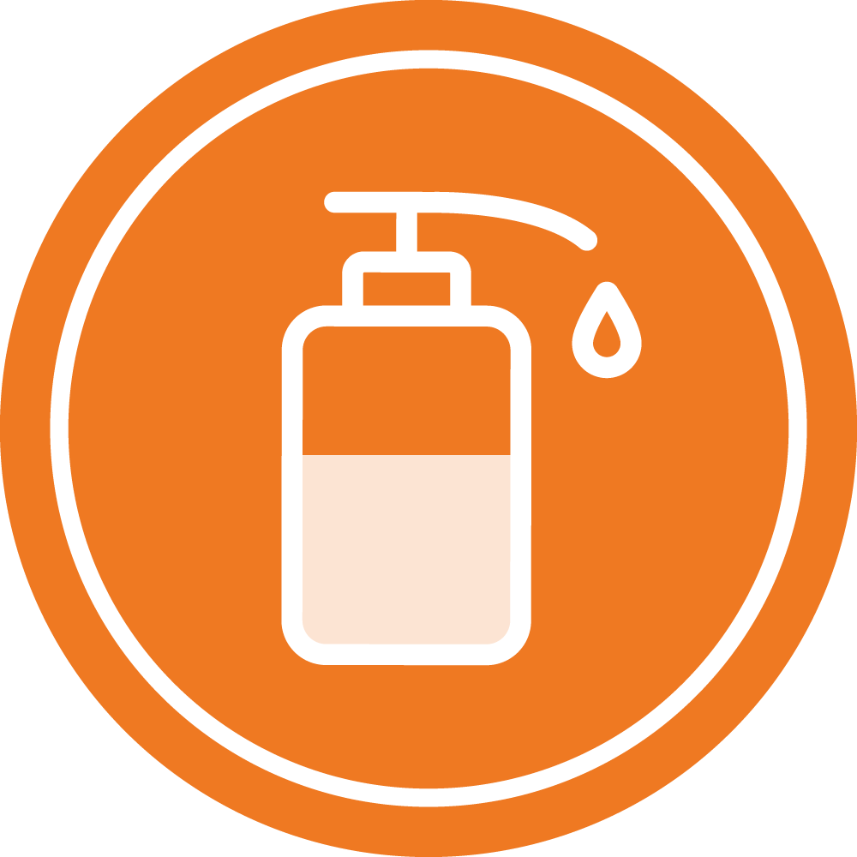
Soap, water, clean towels –
or alcohol based handrub.

Slide 7
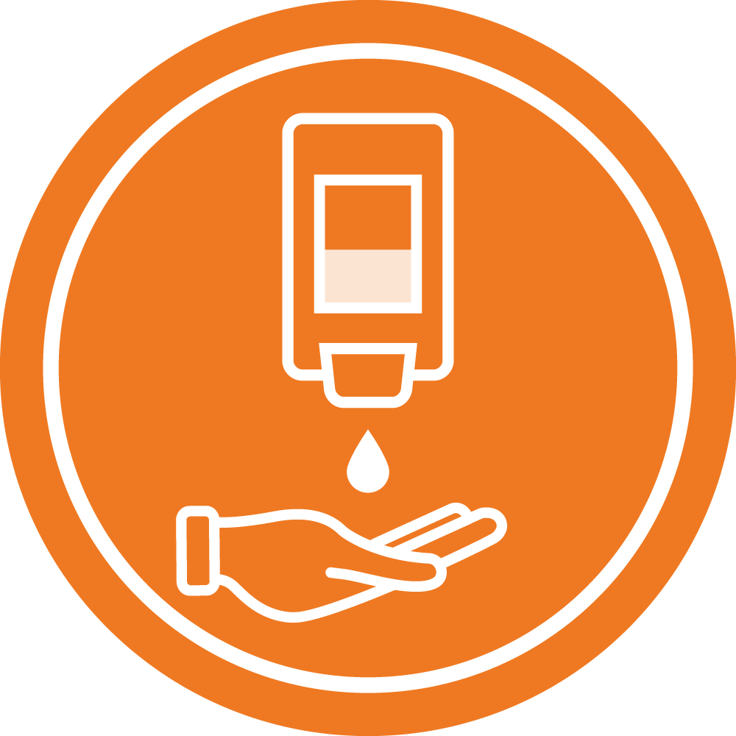
By making sure that facilities are designed to make it easy for health workers to clean their hands when and where they need to.

Slide 8

And by making sure they know how to use them effectively.

Slide 9

There's a reason alcohol based handrub is listed as a WHO Essential Medicine.

Slide 10

It can save lives!

