Slide 1


Slide 2

Hundreds of millions of people are affected by avoidable infections in health care.
1 in 10 infected patients die every year.

Slide 3

Effective infection prevention and control measures prevent up to 70% of infections acquired in health care.

Slide 4

Effective infection prevention and control measures prevent up to 70% of infections acquired in health care.

Slide 5
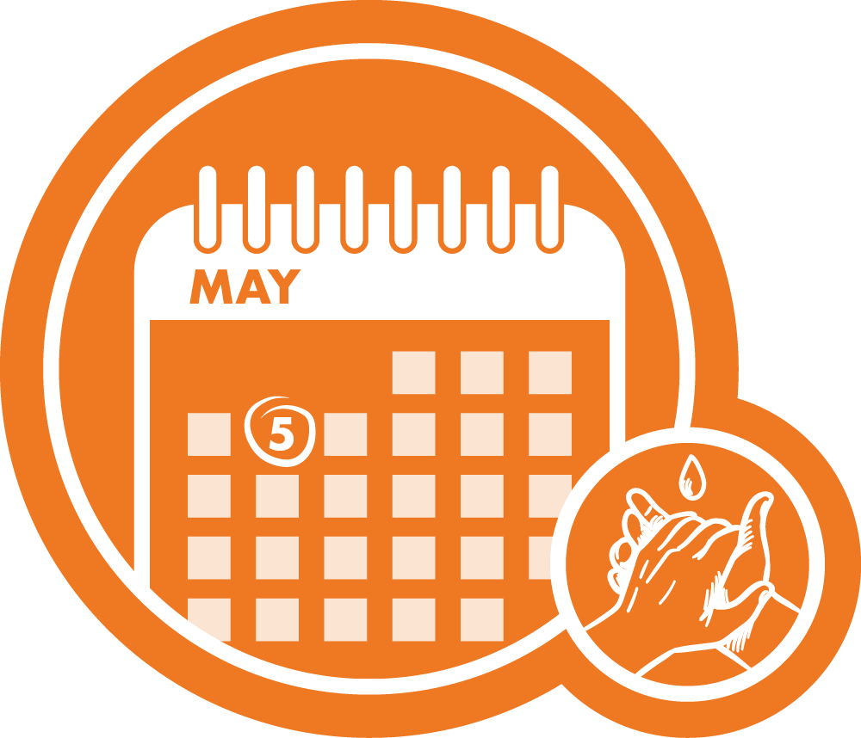
Today and every day clean your hands to prevent infections and help keep us all safe.

Slide 6
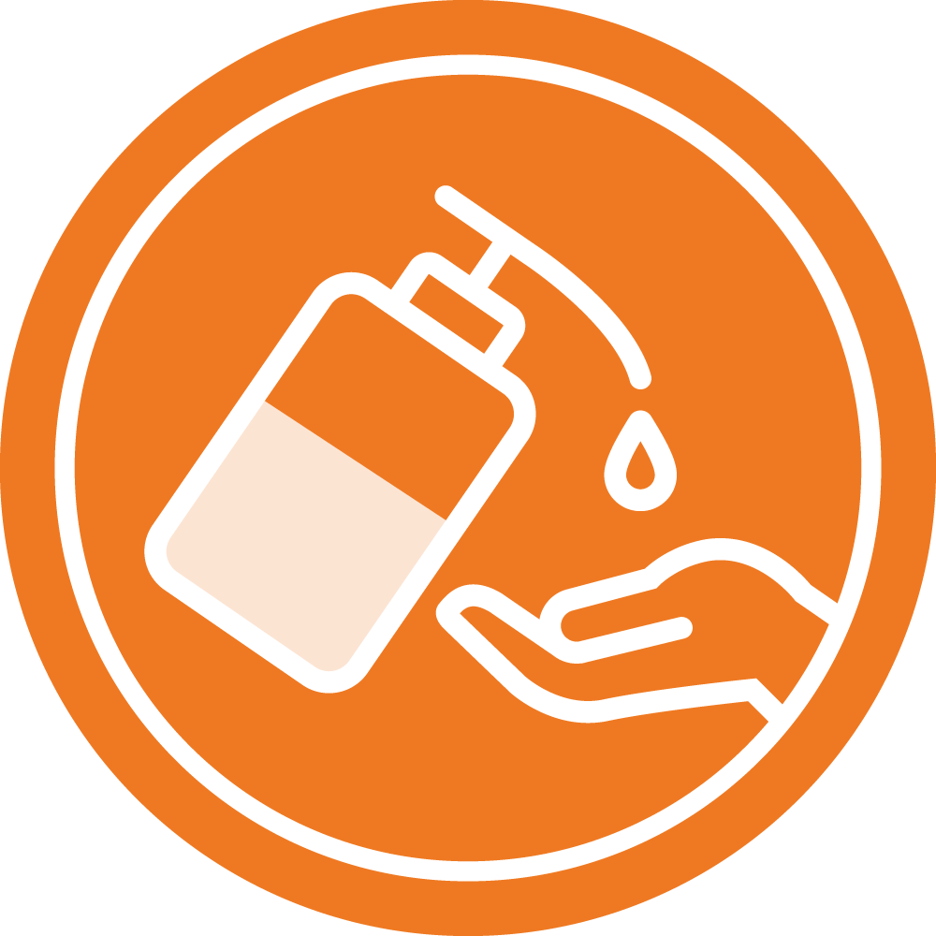
Cleaning your hands is one of the most effective measures in reducing the spread of germs and avoiding infections.

Slide 7
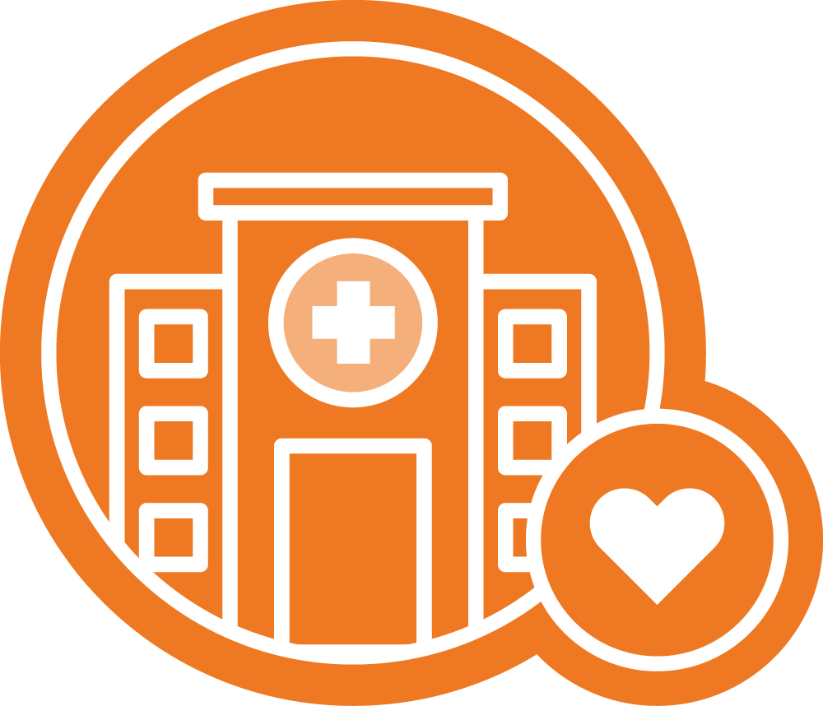
Your health workers keep you safe by cleaning their hands at the right times in the right way.

Slide 8
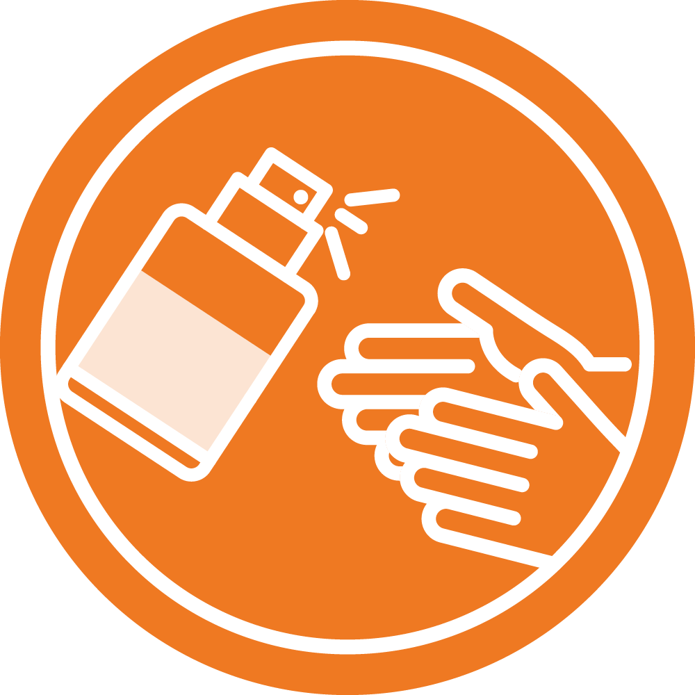
Access to the right hand hygiene products helps everyone stay safe.

Slide 9
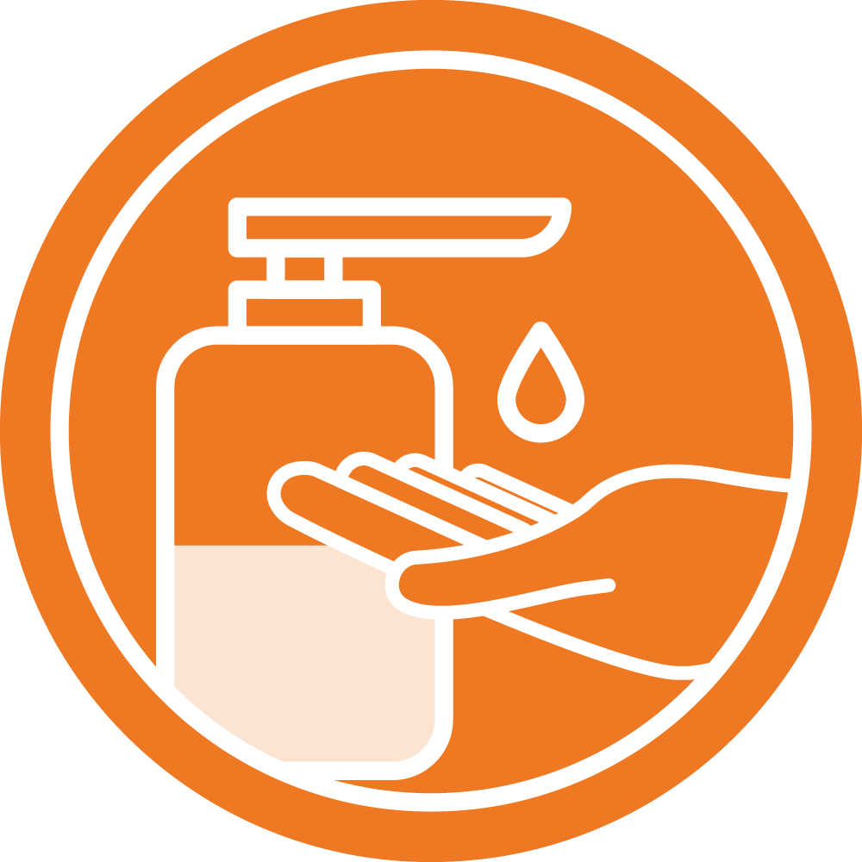
Get involved in hand hygiene campaigns at your local health care facility.

