Slide 1
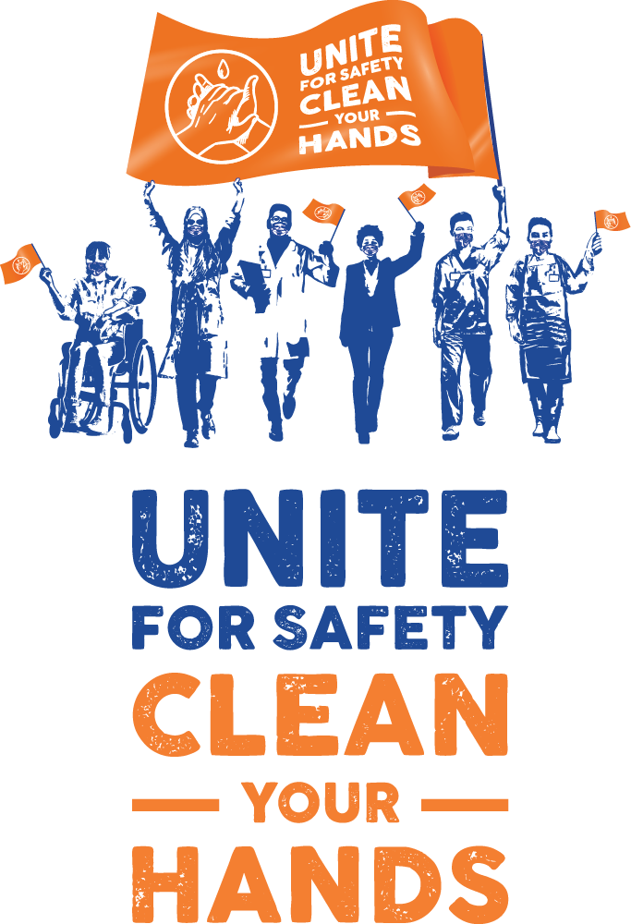

Slide 2
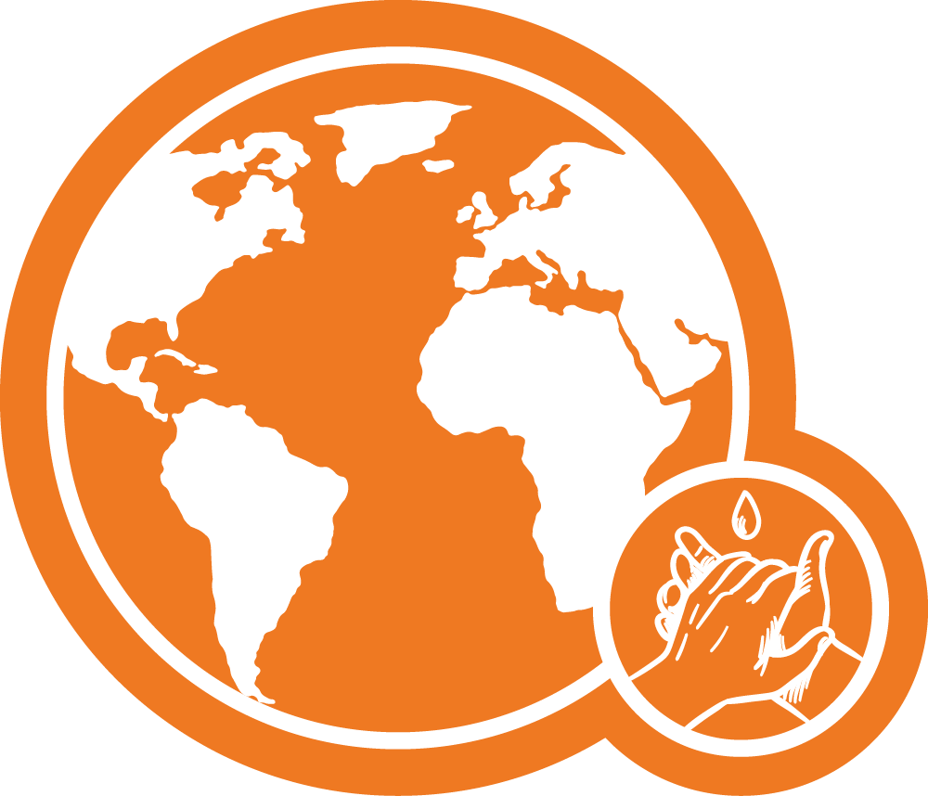

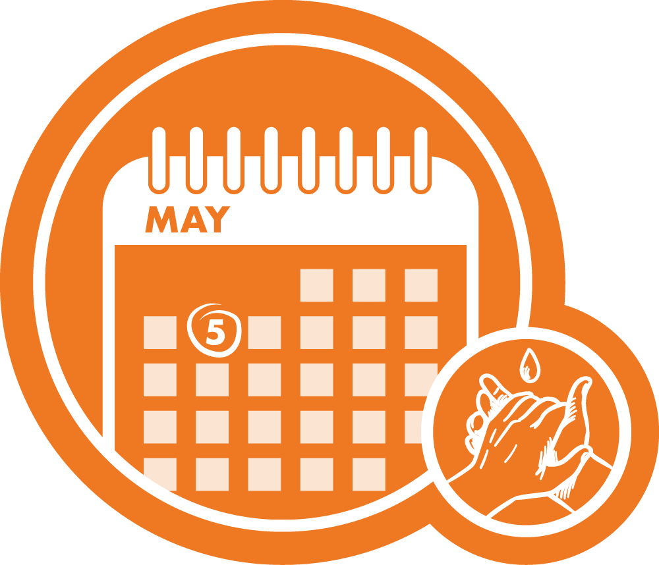
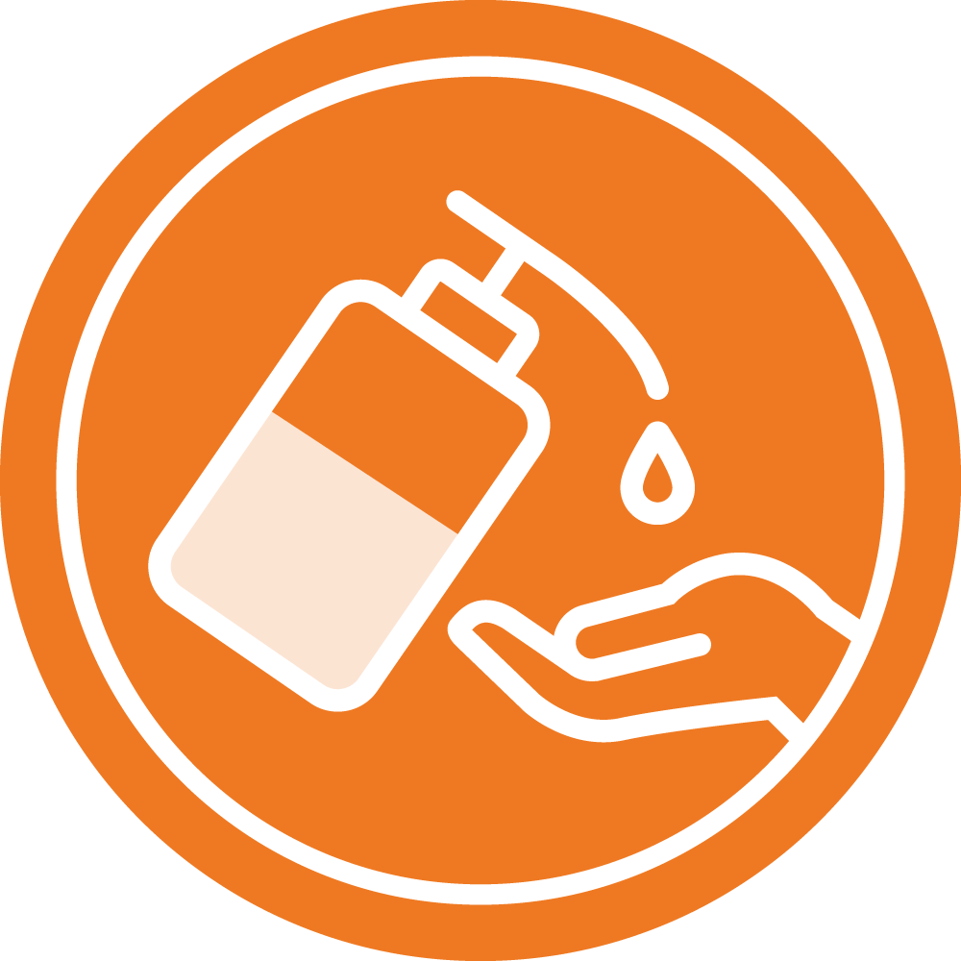

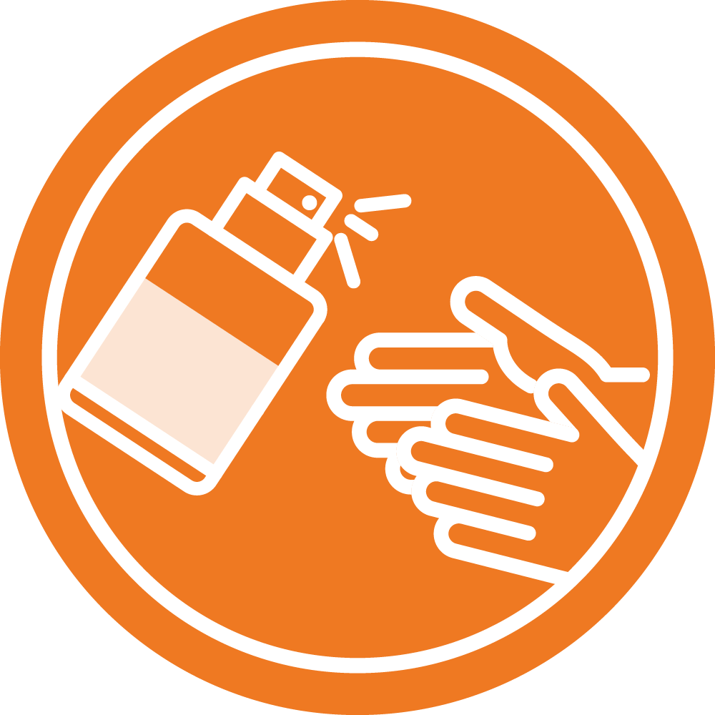
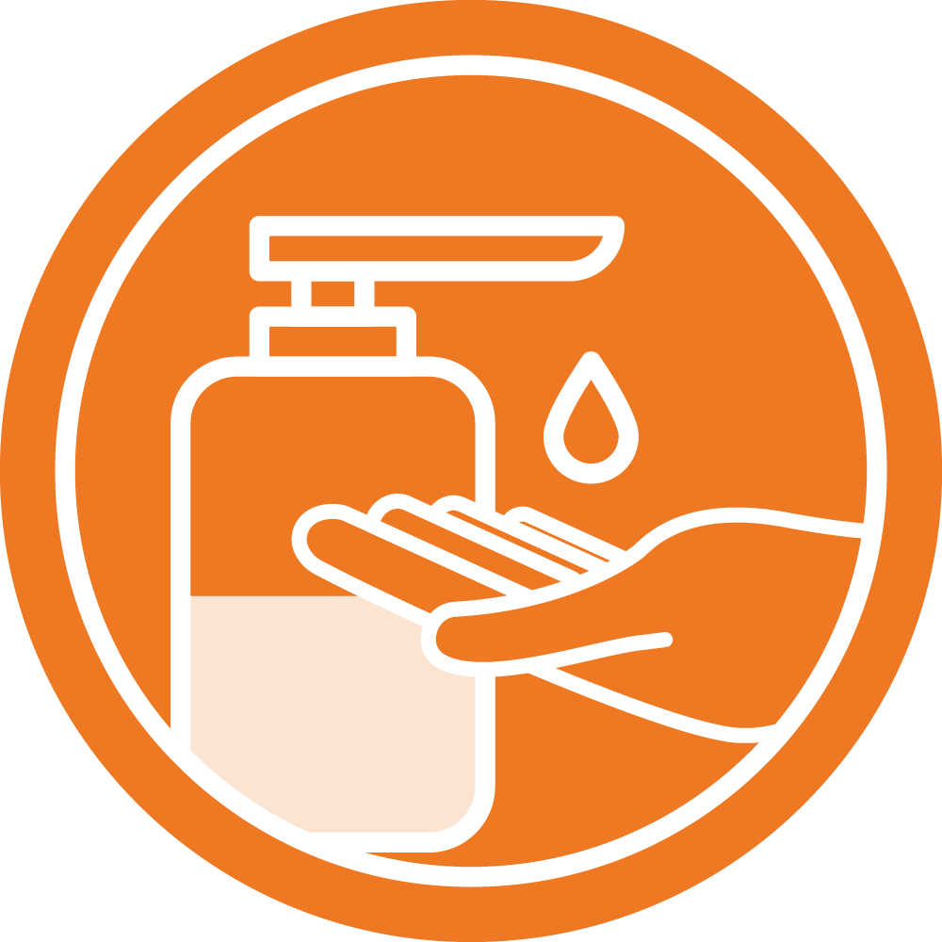
Hundreds of millions of people are affected by avoidable infections in health care.
1 in 10 infected patients die every year.
Effective infection prevention and control measures prevent up to 70% of infections acquired in health care.
Today and every day clean your hands to prevent infections and help keep us all safe.
Cleaning your hands is one of the most effective measures in reducing the spread of germs and avoiding infections.
Your health workers keep you safe by cleaning their hands at the right times in the right way.
Access to the right hand hygiene products helps everyone stay safe.
Get involved in hand hygiene campaigns at your local health care facility.

