Slide 1
Age
12+
2-6
PLAYERS
SURVIVAL GAME
Microbes are everywhere!
Can you survive?
What’s the goal?
The goal is for the player to effectively fight 5 micro-organisms/germs.
Content:
1 Board, 6 pawns, 1 dice, 25 microorganism cards (15 bacteria cards, 10 fungus cards, 10 virus cards), 39 treatment cards (10 antibiotic cards, 5 antifungal drug cards, 12 antiserum cards, 12 vaccine cards), 13 mystery cards.

Slide 2
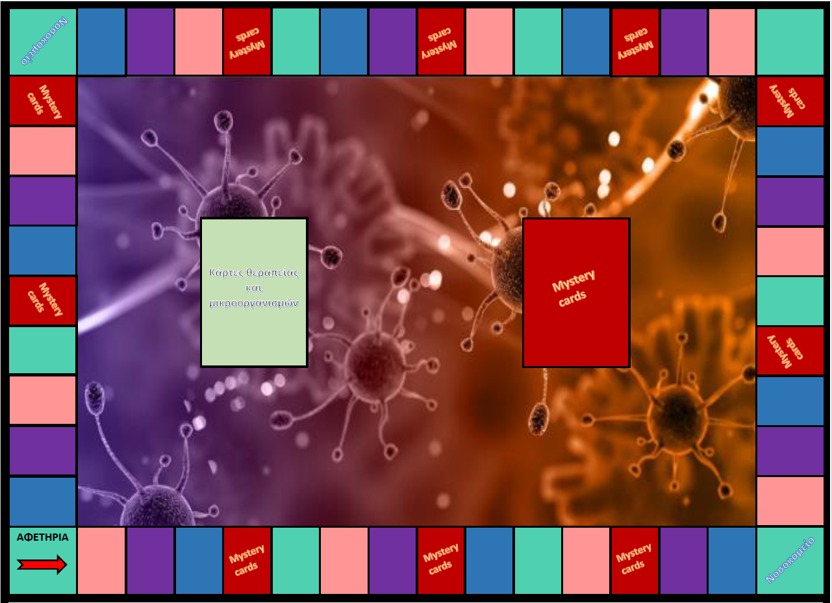
Set up:
Each player takes randomly 3 Treatment cards.
Shuffle the treatment and microorganism cards and place them face down in the appropriate position on the board.
Do the same for the Mystery cards and place them next to the other cards.
Each player chooses a pawn.
Place the pawns at the STARTING point.

Slide 3
Game rules:
All players start with 3 Treatment cards in hand.
All pawns start from the starting point START.
Ask which player got sick last. That player rolls the die first and proceeds based on the number shown on the die.
Α) If the pawn stops on a red square, the player takes a mystery card, follows the instruction, and if it is possible, the player uses this card to fight a microorganism that already has in hand.
Β) If the pawn rests on any other colored square, the player takes a card from the “Treatment and Microorganisms cards” stack.
  If the player takes a Μicroorganism card, then the player attempts to fight the microorganism using the Treatments cards in hand (See pages 4 and 5). If successful, the Treatment card is placed in front of the player and the Μicroorganism card is placed in the center of the board between the 2 stacks. If the player cannot fight it, then the microorganism stays in the player's hand for the next rounds.
  If the player takes a Treatment card, then the player adds it to the remaining cards in their hand. The player can use this card to fight a microorganism card drawn from a previous round.
  C. If the pawn lands on a square with the word "Hospital", then the player takes all the micro-organisms that were fought and placed in the center of the board. If there are no microorganism cards, then the player gets no cards.
4. Next player's turn. The above steps are repeated.
5. Continue the game until one player fights 5 microorganisms!

Slide 4
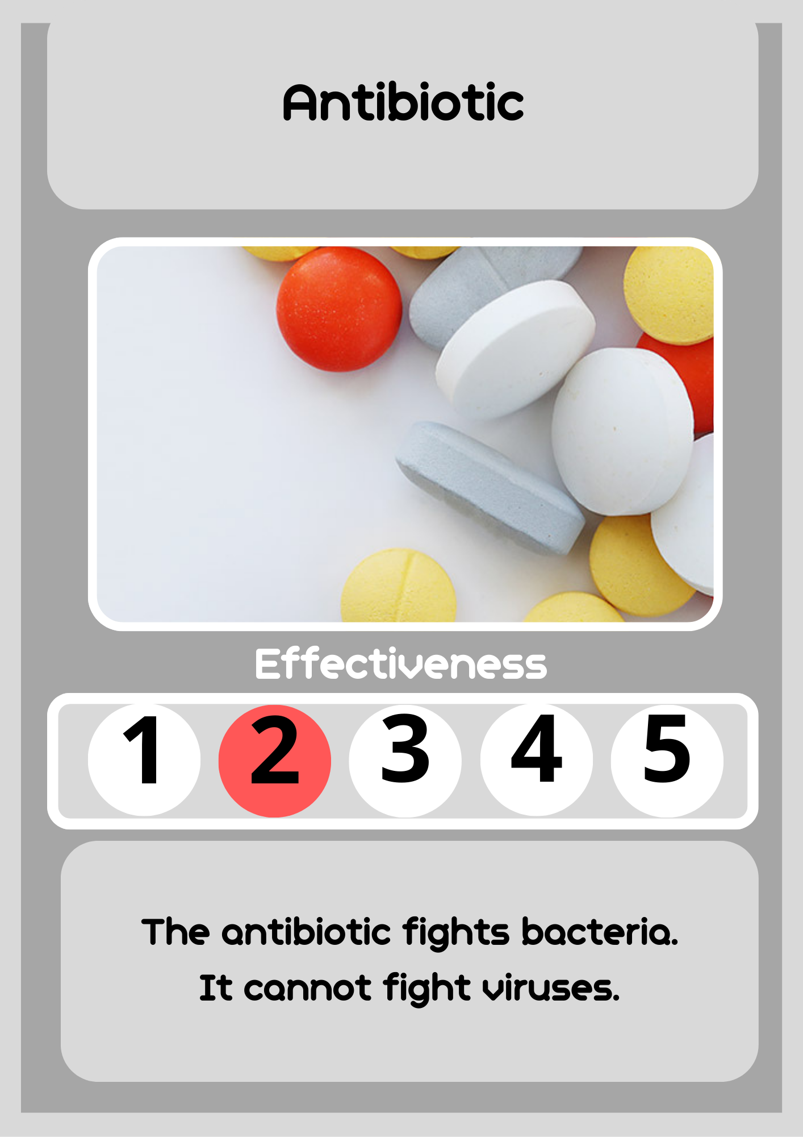
How to fight microorganisms:
How can I fight a microorganisms using the Treatment card:
Each microorganism can only be fought when the circled number on each Antibiotic card is greater than or equal to the number on the player's Microorganism card.
Note: Antibiotic cards can only kill bacteria, not viruses and fungi.
For example: If the circled number on the Microorganism card is 2 then the number on the Antibiotic card must be 2, 3, 4 or 5 to fight the microorganism. If this number is lower, the Microorganism CANNOT be killed.

Slide 5
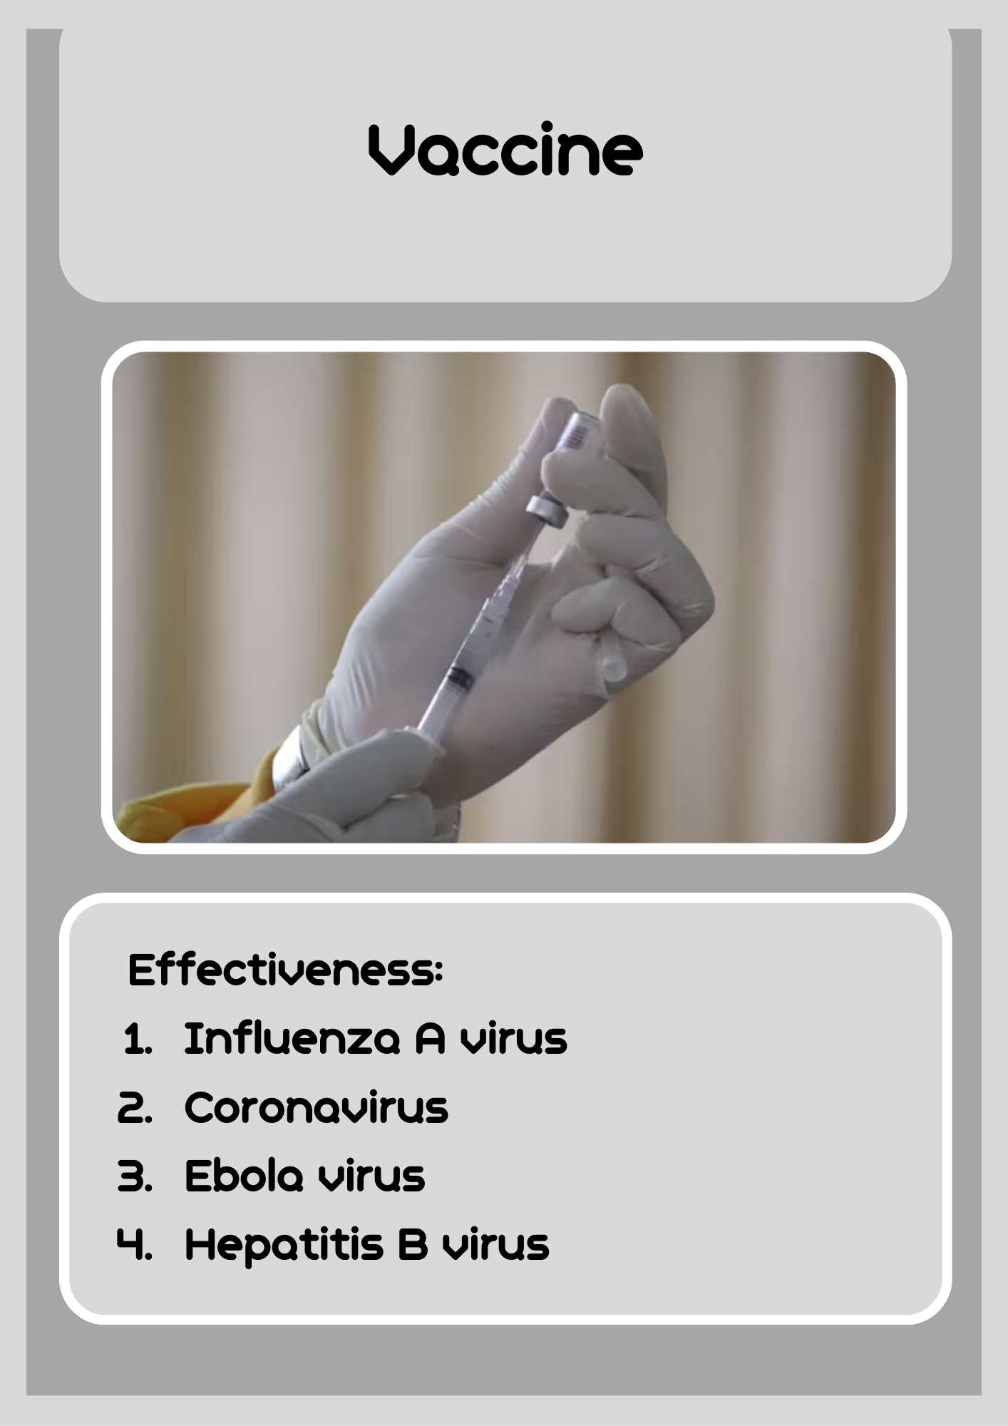
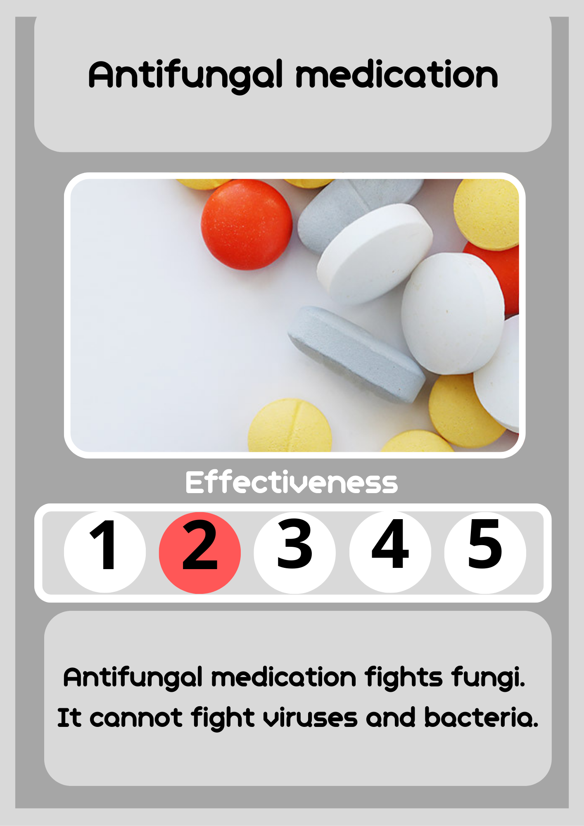
How can I fight a microorganism using a Vaccine or Antiserum card:
All microorganisms, except fungi, can be fought with Vaccine or Antiserum cards if the name of the microorganism is written on the card.
How can I fight a microorganism using an Antifungal medication card:
A microorganism can only be fought when the circled number on each Antifungal medication card is greater than or equal to the number on the player's Microorganism card.
Note: Antifungal medication cards can only kill fungi, not viruses and bacteria.
For example: If the number circled on the Microorganism card is 3 then the number on the Antifungal medication card must be 3, 4 or 5. If the number is lower, the microorganism CANNOT be killed.

Slide 6
Description of the cards
Treatment cards:
Antibiotic:
The Antibiotic card fights Bacteria cards, depending on the card’s strength listed at the bottom of the card (see Effectiveness).
Antifungal medication:
The Antifungal Medication card fights Fungi cards, depending on the card's strength listed at the bottom of the card (see Effectiveness).
Antiserum:
The Antiserum card fights Bacteria and Viruses' cards. Each Antiserum card lists 4 microorganisms that you can fight. With one Antiserum card you can only fight one Microorganism card. When the Antiserum card is used then it’s placed in front of the player and cannot longer be used.
Vaccine:
The Vaccine card fights Bacteria and Viruses’ cards. Each Vaccine card lists 4 microorganisms that you can fight. With one Vaccine card you can only fight one Microorganism card. When the Vaccine card is used then it’s placed in front of the player and cannot longer be used.
Mystery cards:
If the player's pawn stops on a purple square, then the player takes a Mystery card and follows the instructions written on the card.

Slide 7
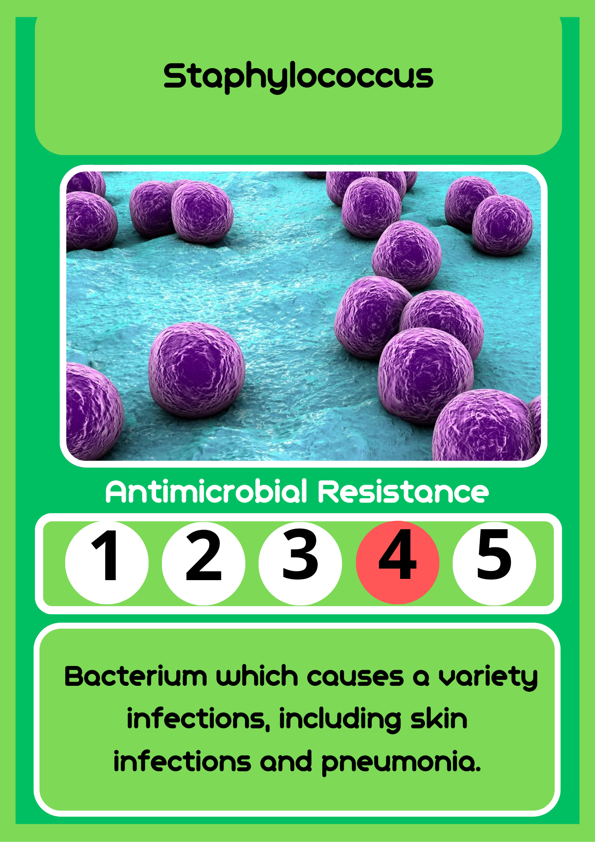
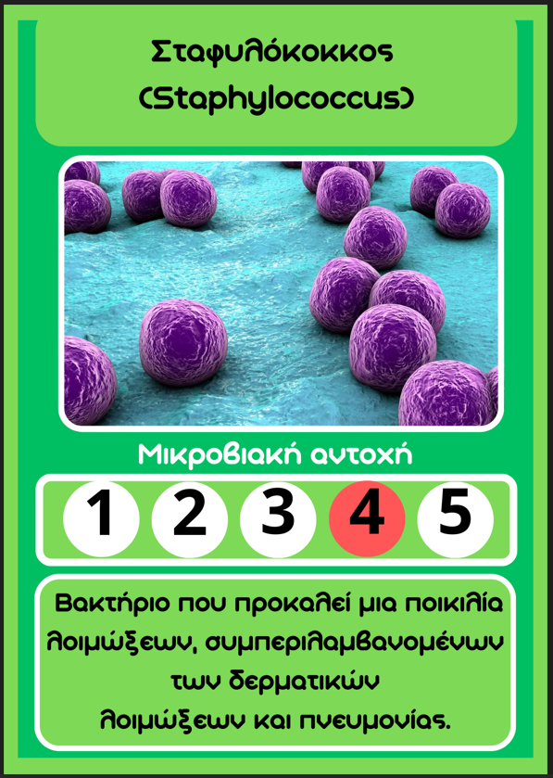
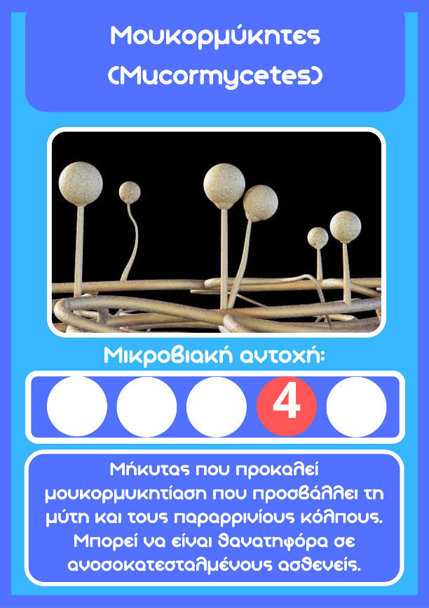
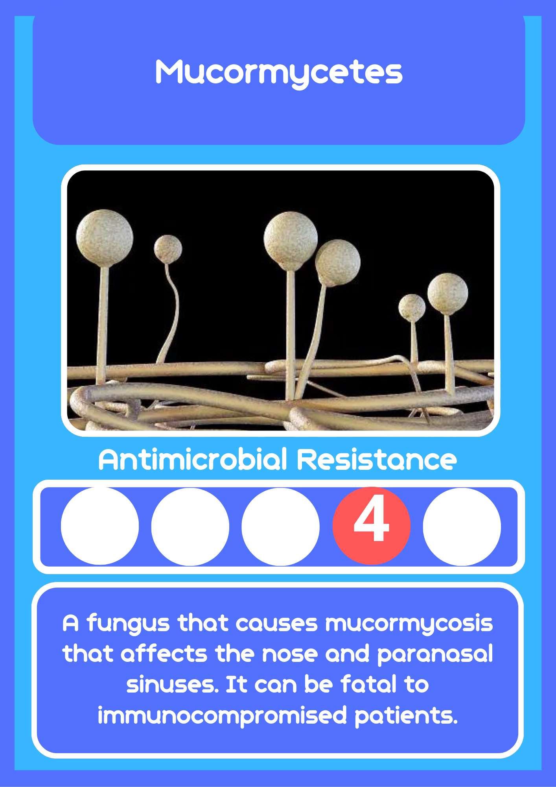
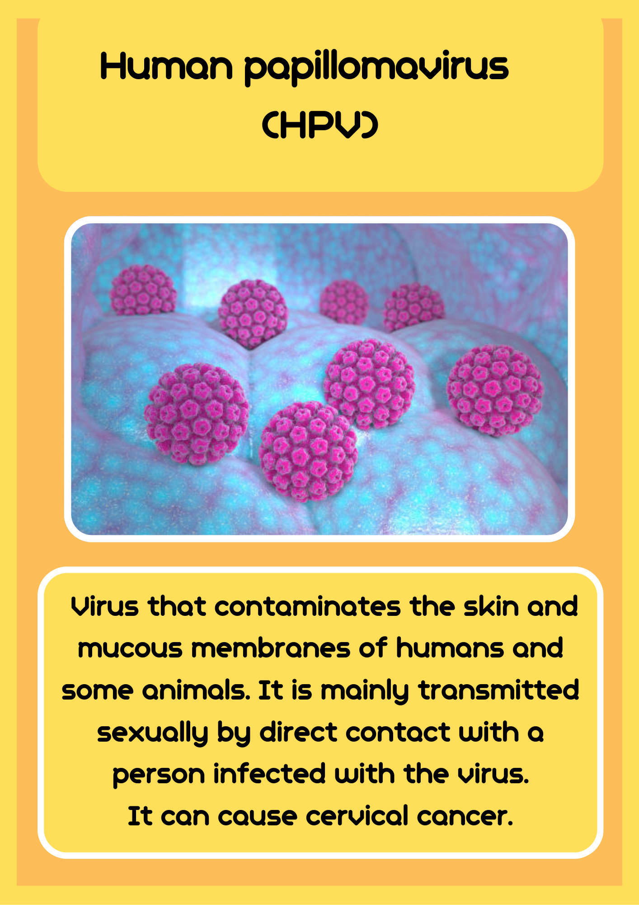
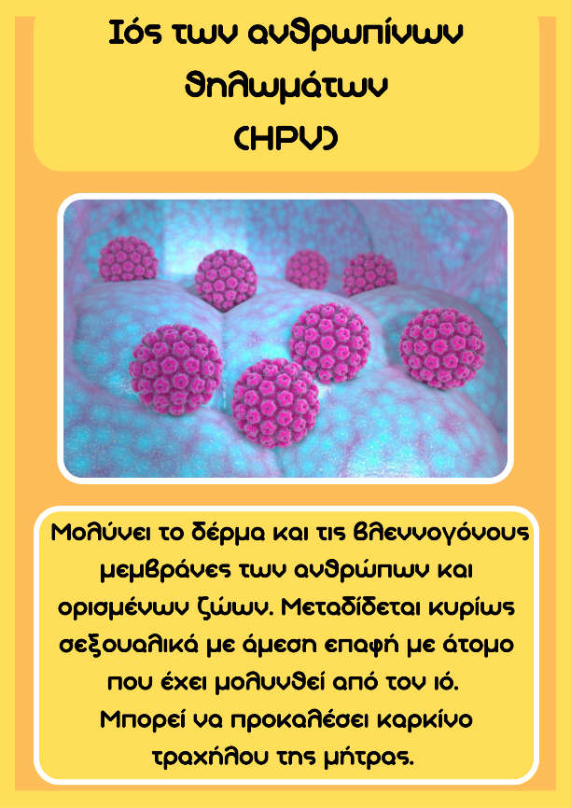
Microorganisms cards:
Bacteria:
Each Bacteria card has an indicative number that shows its antimicrobial resistance. We can fight bacteria cards with an Antibiotic card, and most bacteria can also be killed with Vaccine and Antiserum cards.
Fungi:
Each Fungus card has an indicative number that shows its antimicrobial resistance. We can fight fungi cards only with an Antifungal medication card.
Viruses:
We can fight viruses only with the use of Antiserum or Vaccine cards.

Slide 8
FQA
What are microorganisms?
Microorganisms are organisms that consist of only one cell (single cells). They cannot be seen with a naked eye, but only with the use of a microscope. Such organisms are bacteria, fungi, viruses, and protists.
What are microbes?
Microorganisms are colloquially called microbes or germs. The word comes from 'micros’ (small in Greek) + 'bios' (life in Greek).
What are pathogenic microorganisms?
Pathogenic microorganisms are organisms that cause disease in the organism they infect. For each pathogenic microorganism there is also the corresponding treatment.
Are all microorganisms pathogenic?
Not all microorganisms are pathogens. Some organisms are beneficial to humans either to keep us healthy or for the production of food and beverages. For example, the large intestine contains bacteria that produce and supply vitamin K to humans. In addition, yeast, which is a fungus, is often used to produce bread, while the bacterium Lactobacillus bulgaricus is used to produce yogurt.
What is an antibiotic?
Antibiotic medicine is a medicine given to treat diseases caused by bacteria. The word comes from anti- + biotikos (fit for life, from bios = life).
Why don't antibiotics fight viruses?
Viruses are considered by scientists as non-living organisms since they do not have their own metabolism. The antibiotic affects the metabolism of the cells, thereby causing their death. Since viruses have no metabolism, then they cannot be fought with antibiotics.

Slide 9
What is Antimicrobial Resistance?
Antimicrobial Resistance (AMR) occurs when microbes (bacteria, viruses, fungi and parasites) become resistant and no longer respond to the antimicrobial drugs developed to kill them (e.g., antibiotics and antifungals), resulting in resist and survive. These surviving, drug-resistant microbes are also known as superbugs.
What Causes Antimicrobial Resistance?
The reckless and inconsiderate use of drugs originally designed to fight micro-organisms and the lack of hygiene and cleanliness. Then, existing drugs are no longer effective, and the infection becomes impossible to treat, increasing the risk of serious illness and even death.
Why is Antimicrobial Resistance a serious problem?
Highly resistant germs are spreading worldwide, causing infections that cannot be treated with antimicrobial drugs such as antibiotics. Consequently, infections become increasingly difficult or impossible to treat, increasing the risk of serious illness and even death. The World Health Organization (WHO) has declared Antimicrobial Resistance as one of the 10 threats to global health.
What can you do to prevent the spread of Antimicrobial Resistance?
Use ANTIBIOTICS to treat infections caused only by bacteria, not viruses.
Use antimicrobial drugs only when necessary, following your doctor's advice.
Wash your hands regularly to prevent the spread of germs.
Get informed and be updated!

Slide 10
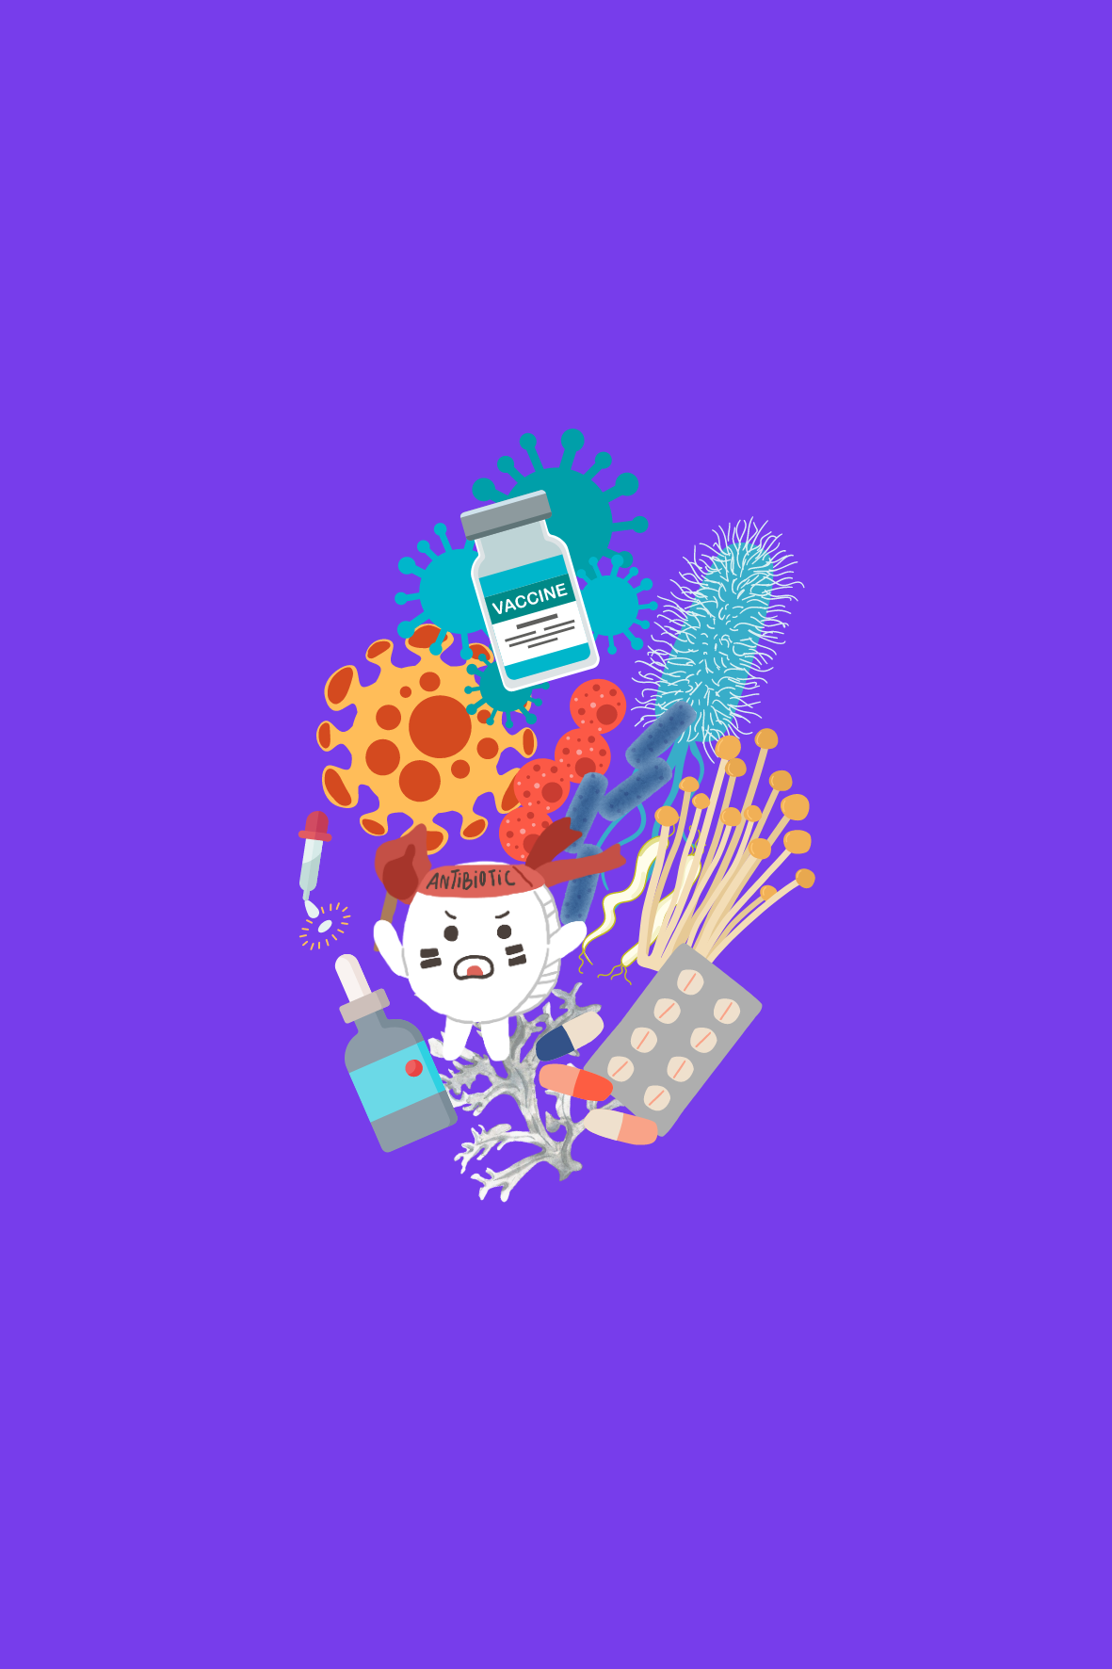






The board game was developed and designed by a group of students at PASCAL Private Greek School Nicosia in the context of the MULTIPLIERS European project (https://multipliers-project.org/ GA No. 101006255) which is coordinated by the Learning in Science Group (LSG) of the University of Cyprus.
The development and design of the board game was overseen by the following students:
Antoniou Marios
Antoniou Symeon
Achilleos Andreas
Thoma Marios
Kapsouli Anastasia
Maifoshis Andreas
Mavridou Ioanna
Michalaki Maria Eleni
Mylona Maria
Odysseos Chrsitina
Pavlou Stefanos Maximos
Under the supervision of the biology teacher Mrs. Stella Pantazi in collaboration with Dr. Irene Drymiotou.
Notes:
Add logos UCY, LSG, Multipliers, Pascal

