Slide 1
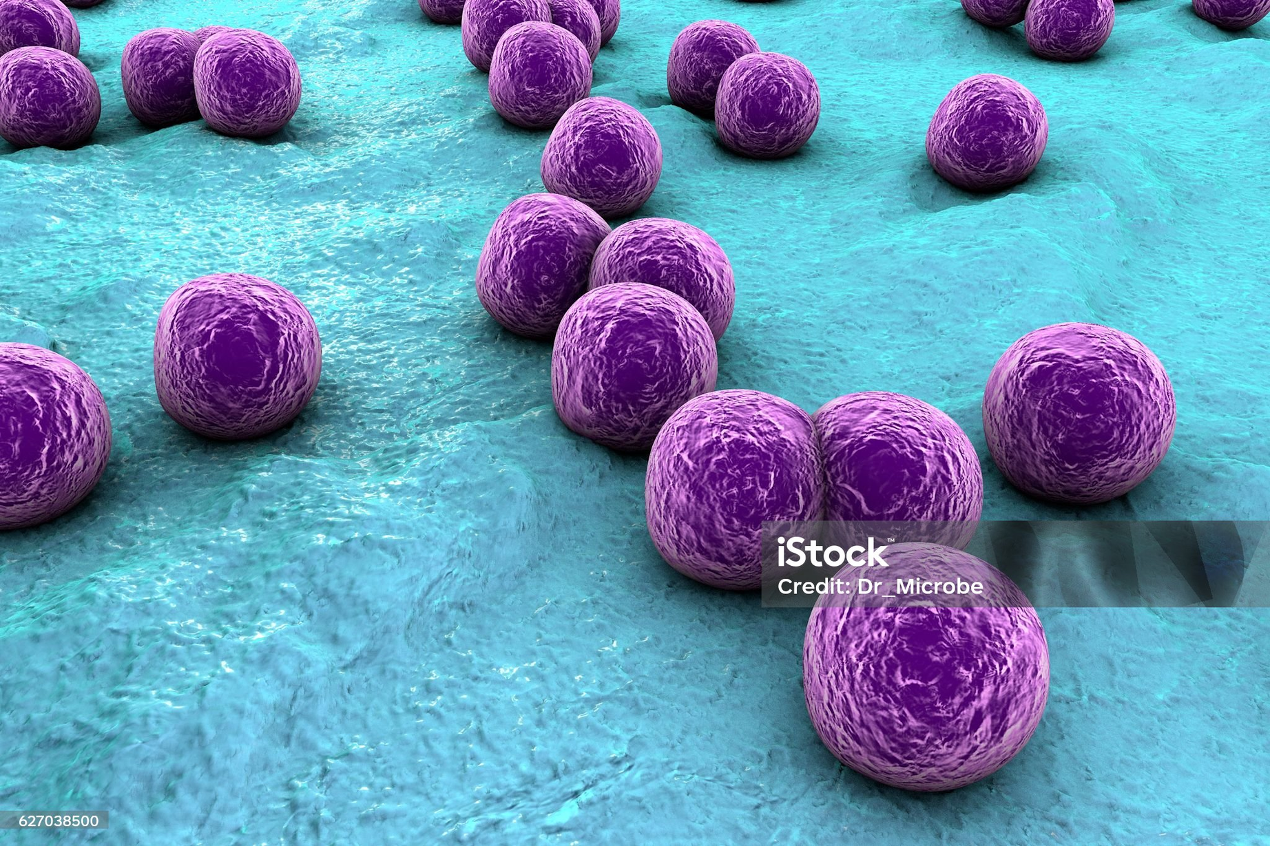
Staphylococcus
Antimicrobial Resistance
1
2
3
4
5
Bacterium which causes a variety
infections, including skin
infections and pneumonia.

Slide 2

Streptococcus
Antimicrobial Resistance
1
2
3
4
5
Bacterium which causes respiratory, skin and other infections, as well as
increased risk of endocarditis.

Slide 3

Escherichia coli
Antimicrobial Resistance
1
2
3
4
5
Bacterium which causes various
infections, including bladder infections.

Slide 4

Shigella
Antimicrobial Resistance
1
2
3
4
5
Βacterium which causes dysentery, an inflammatory intestinal infection.

Slide 5
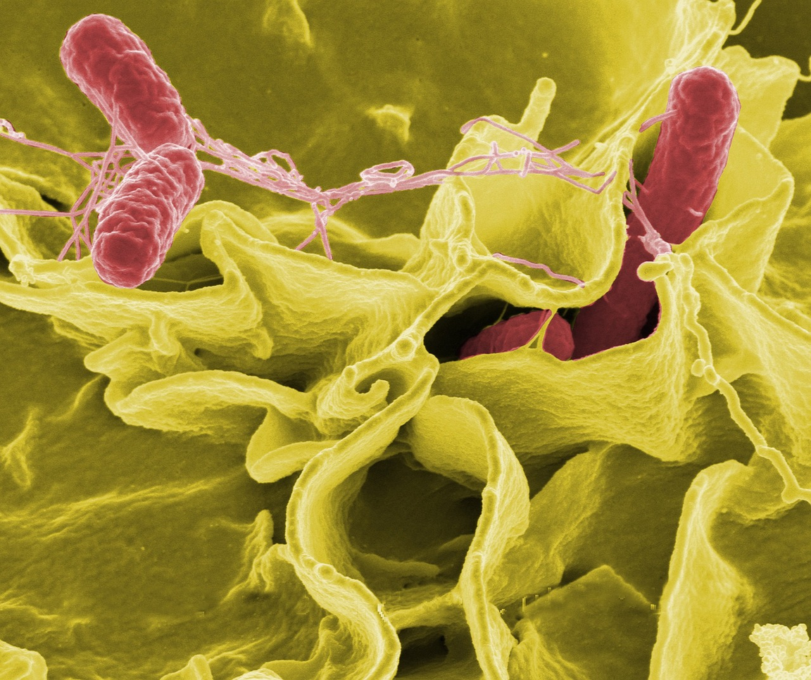
Salmonella
Antimicrobial Resistance
1
2
3
4
5
Βacterium which which causes salmonellosis, a diarrhoea caused by contaminated food.

Slide 6
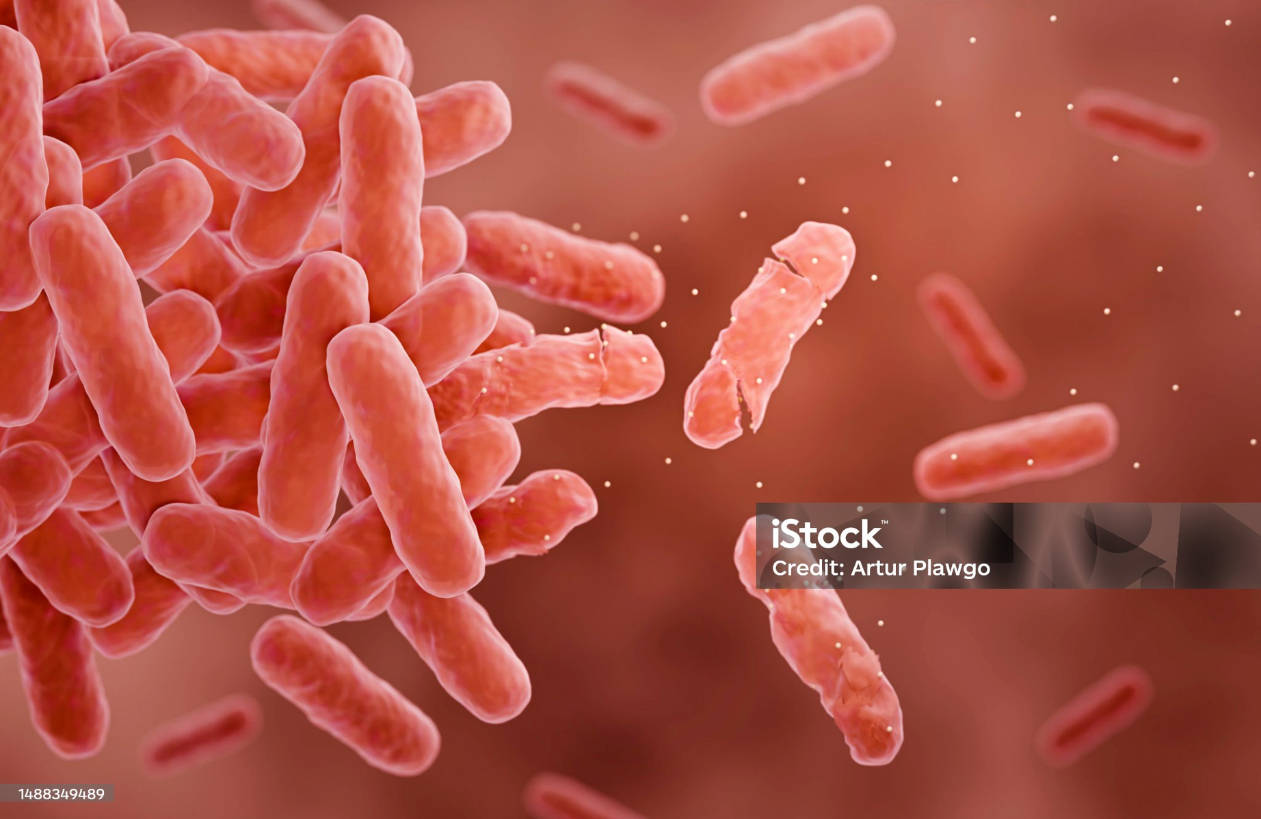
Clostridium
Antimicrobial Resistance
1
2
3
4
5
Certain species of Clostridium bacterium cause toxic shock and other dangerous infections.

Slide 7

Streptococcus pneumonia
Antimicrobial Resistance
1
2
3
4
5
A bacterium which mainly causes pneumonia and other infections too such as otitis, meningitis.

Slide 8

Bacillus cereus
Antimicrobial Resistance
1
2
3
4
5
Bacterium that causes gastrointestinal diseases.

Slide 9
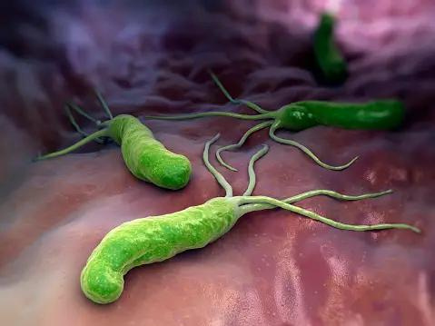
Helicobacter pylori
Antimicrobial Resistance
1
2
3
4
5
Bacterium that causes ulcers in the stomach and duodenum.

Slide 10
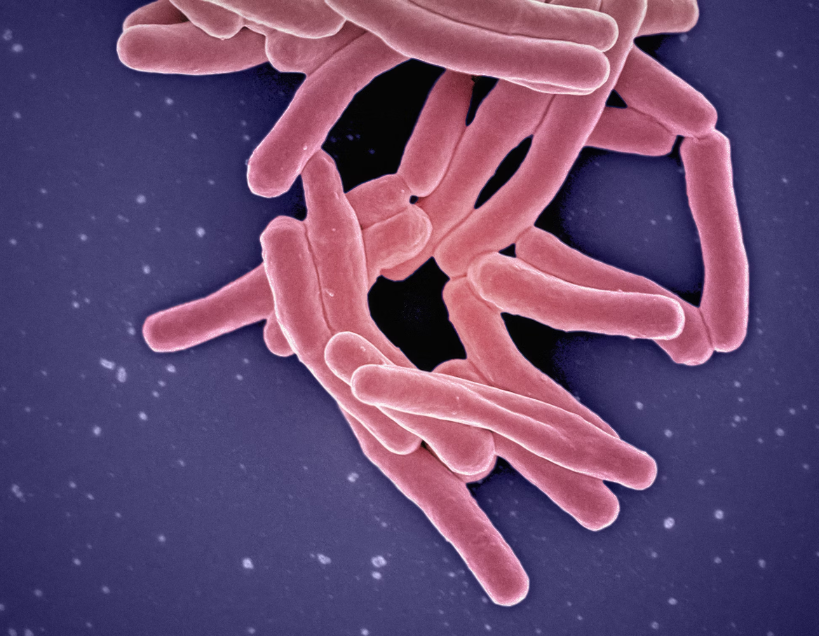
Mycobacterium tuberculosis
Antimicrobial Resistance
1
2
3
4
5
Bacterium that causes tuberculosis, a serious lung disease.

Slide 11

Vibrio cholerae
Antimicrobial Resistance
1
2
3
4
5
Bacterium that mainly causes cholera, a disease that causes diarrheal discharge.

Slide 12

Legionella
Antimicrobial Resistance
1
2
3
4
5
Bacterium that causes Legionnaires' disease, an acute disease of the respiratory system.

Slide 13

Streptococcus pyogenes
Antimicrobial Resistance
1
2
3
4
5
Bacterium that causes streptococcal pharyngitis especially in children >3 years and skin infections such as scarlet fever.

Slide 14

Neisseria meningitidis
Antimicrobial Resistance
1
2
3
4
5
Bacterium that mainly causes meningitis.

Slide 15

Proteus mirabalis
Antimicrobial Resistance
1
2
3
4
5
Bacterium that mainly causes urological infections but also other diseases such as pneumonia, meningitis. There is no vaccine against Proteus.

