Slide 1
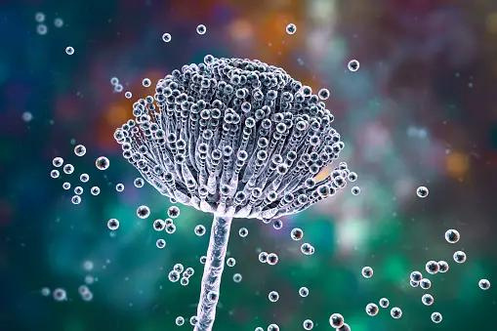
Aspergillus fumigatus
Antimicrobial Resistance
1
2
3
4
5
Fungus that causes pulmonary aspergillosis and manifests itself mainly in people whose immune system is underfunctioning.

Slide 2
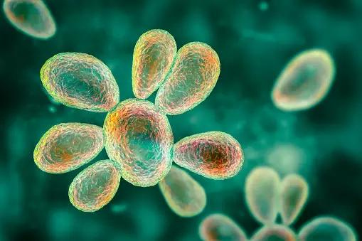
Blastomyces
Antimicrobial Resistance
1
2
3
4
5
Also known as yeast. Some of its species however can cause infections such as blastomycosis, a lung infection, from a fungus found in wood and soil.

Slide 3
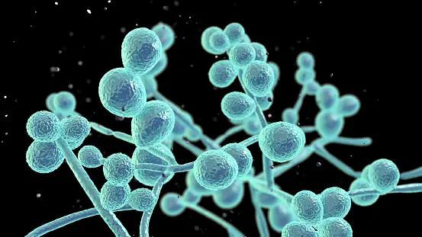
Candida albicans
Antimicrobial Resistance
1
2
3
4
5
Fungus that causes stomatitis, vaginitis or pulmonary candidiasis, depends on the organ that will be affected.

Slide 4
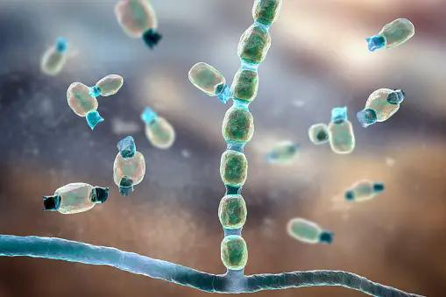
Coccidioides
Antimicrobial Resistance
1
2
3
4
5
It is found on the ground and transmitted through the air. It causes coccidioidomycosis or valley fever and rashes.

Slide 5
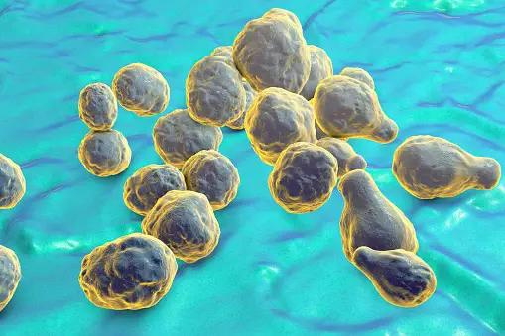
Cryptococcus neoformans
Antimicrobial Resistance
1
2
3
4
5
It causes cryptococcosis with symptoms that look like bronchitis. It is found in the environment and mainly affects immunocompromised patients.

Slide 6
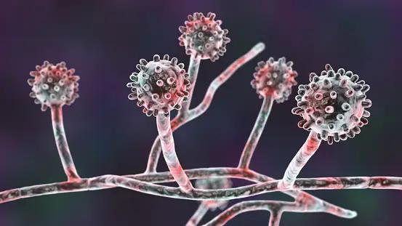
Histoplasma capsulatum
Antimicrobial Resistance
1
2
3
4
5
Fungus that is found in the environment and can cause an infection in the lung. Some of the symptoms are fever, cough and fatigue.

Slide 7
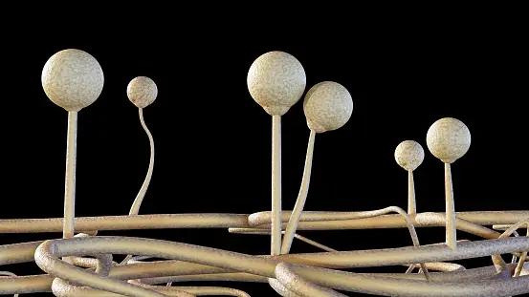
Mucormycetes
Antimicrobial Resistance
1
2
3
4
5
A fungus that causes mucormycosis that affects the nose and paranasal sinuses. It can be fatal to
immunocompromised patients.

Slide 8
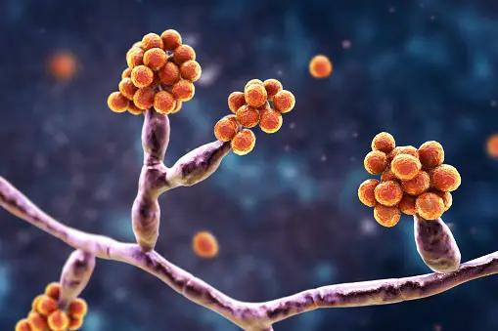
Epidermophyton
Μικροβιακή αντοχή:
1
2
3
4
5
Fungus that causes ringworm, which is a fungal infection of the skin.

Slide 9
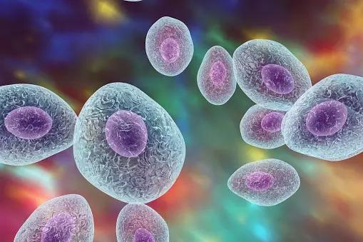
Pneumocystis jirovecii
Antimicrobial Resistance
1
2
3
4
5
Fungus that causes pneumonia in immunocompromised patients and especially in HIV patients.

Slide 10
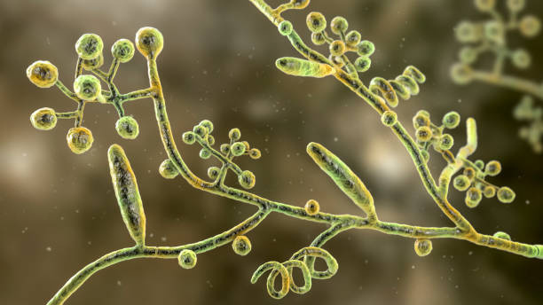
Trichophyton rubrum
Antimicrobial Resistance
1
2
3
4
Fungus that causes dermatophytosis, i.e. circular rashes on the body. It thrives in warm, moist areas on the skin (eg, between the toes).

