Slide 1
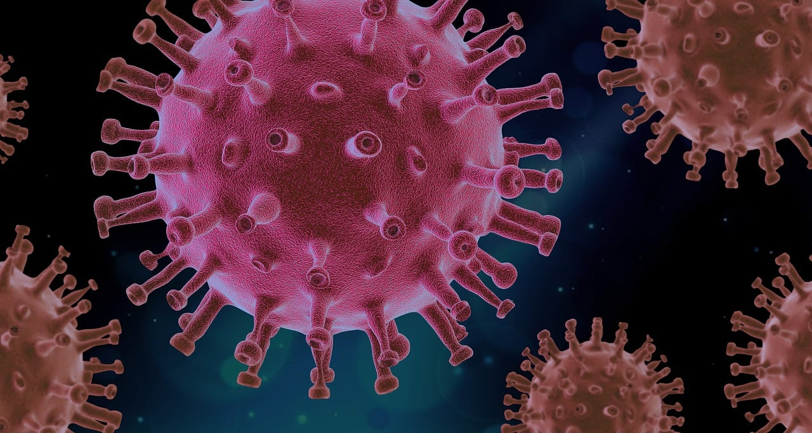
Coronavirus (Covid-19)
Virus that causes infection of the respiratory system. It can be spread through contact with infected people.
Adhering to measures such as wearing a mask and washing hands helps prevent its transmission.

Slide 2
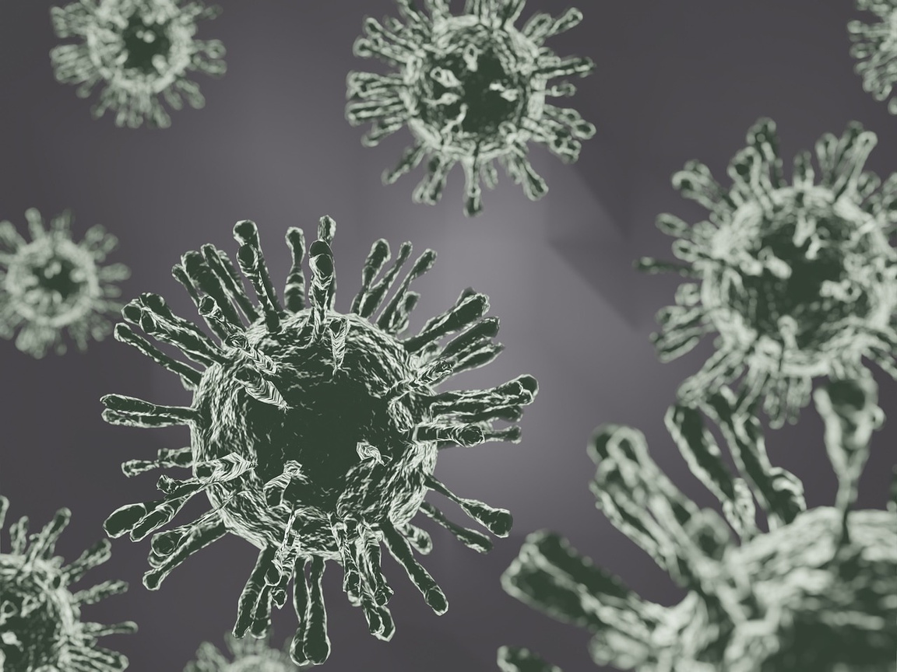
Ιnfluenza Α virus
Influenza type A virus causes an infection of the respiratory system, the well-known swine flu. It is accompanied by symptoms such as fever, cough, headache, and fatigue. The best protection is vaccination and good hygiene practices.

Slide 3

Hepatitis B virus (HBV)
Virus that affects the liver
causing inflammation. It is transmitted through contact with contaminated bodily fluids. Some symptoms are jaundice, dark urine and fatigue.

Slide 4
Hepatitis A virus (HΑV)
Virus that affects the liver
causing inflammation. The illness can cause fatigue, fever, constipation, and loss of appetite.

Slide 5
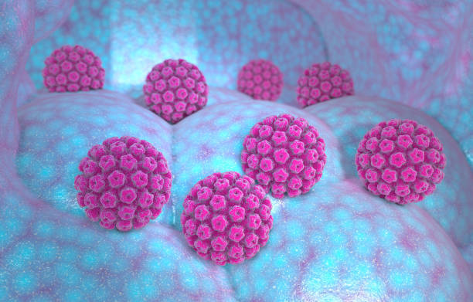
Human papillomavirus
(HPV)
Virus that contaminates the skin and mucous membranes of humans and some animals. It is mainly transmitted sexually by direct contact with a person infected with the virus.
It can cause cervical cancer.

Slide 6
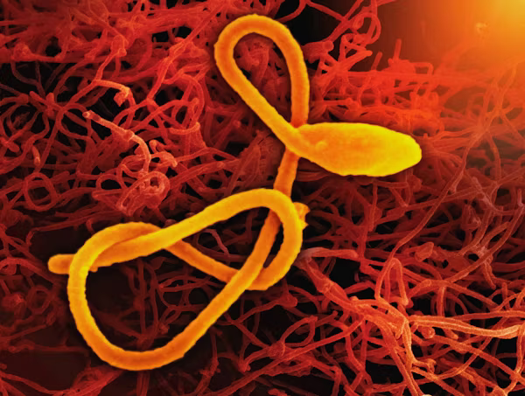
Εbola virus
Ανακαλύφθηκε το 1976 κοντά στον ποταμό Έμπολα στη Λαϊκή Δημοκρατία του Κονγκό. Προκαλεί τον αιμορραγικό πυρετό Εμπόλα σε ανθρώπους και άλλα θηλαστικά. Τα αρχικά συμπτώματα είναι πυρετός, πονοκέφαλος, μυαλγίες.

Slide 7

Mumps virus
It causes mumps, an infection that mainly affects the parotid glands, which can cause swelling and pain in the throat, as well as fever.

Slide 8
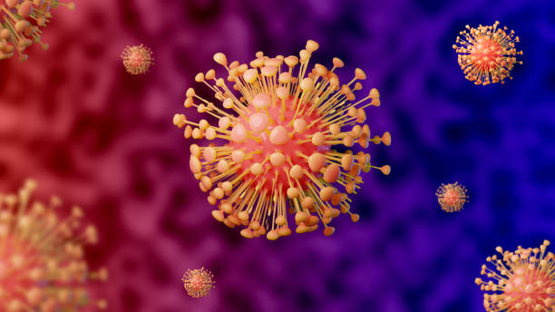
Chickenpox virus
(VZV)
It causes chickenpox, that is the appearance of rashes with fever. It occurs mostly during childhood but can remain latent and manifest later like herpes zoster. It is transmitted by infected droplets.

Slide 9
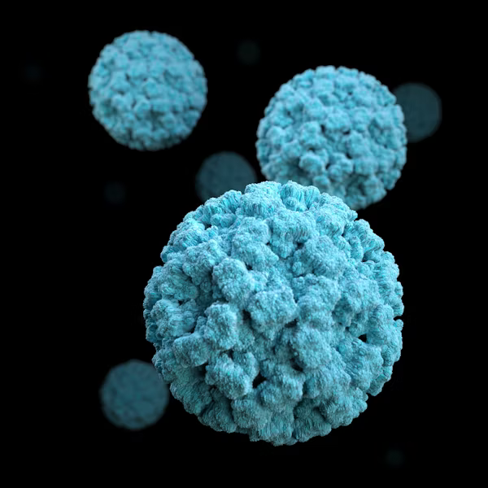
Poliovirus
Virus that causes a serious infection that affects the nervous system, causing poliomyelitis, a disease that can lead to paralysis and, in severe cases, death.

Slide 10
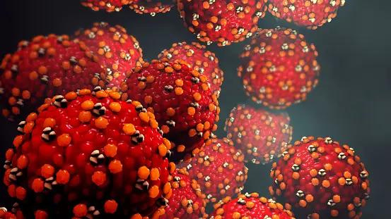
Morbillivirus - Μeasles
It causes measles disease. Symptoms usually appear 10-12 days after infection and initially include a runny nose, cough, mild fever and conjunctivitis. It spreads very quickly to people of all ages.

